Slide 1


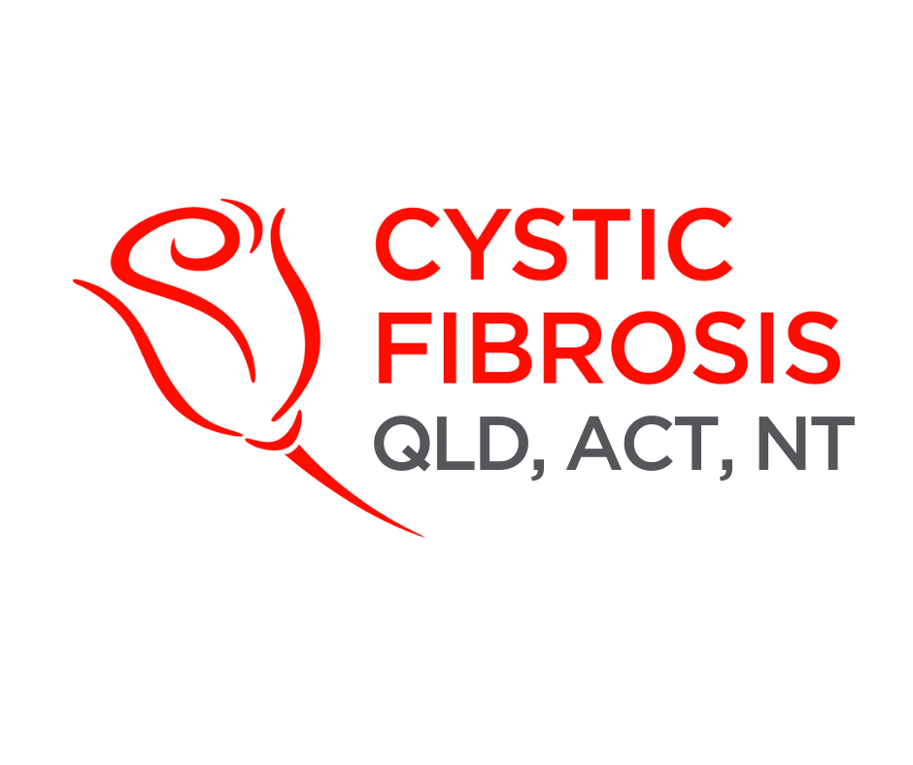
Welcome to CF CAN
Module 1:
Introduction and Orientation
Cystic Fibrosis Community Advocacy Network

Slide 2


What is CF CAN?
Who participates?
Participants can include:
People living with cystic fibrosis
Families
Carers
Supporters
People like you!
Notes:
Section 1.1: What is CF CAN?
Empowering the Cystic Fibrosis Community Through Advocacy
The Cystic Fibrosis Community Advocacy Network, or CF CAN, aims to create a network of individuals affected by cystic fibrosis, and better equip them with the knowledge, skills and confidence to advocate for systemic change, better care, and stronger community voices.
So, who can engage with CF CAN?
CF CAN is for anyone with a connection to cystic fibrosis, this includes people living with cystic fibrosis, their families, carers and supporters.
What to expect…
The package will include 7 modules, involving slides, key messages and takeaways. Complete these at your own pace or as part of a group workshop. Each module will take approx. 45 minutes each.
Know your audience: Start with a quick check-in — ask participants to introduce themselves and share what advocacy means to them. This tailors the session to their backgrounds and goals.

Slide 3



Purpose and Vision
Through advocacy, CF CAN works towards achieving the following goals:
Increasing equitable access to care
Amplifying patient voices
Influencing policy
Notes:
Section 1.2: Purpose and Vision, why is this training important?
Becoming an advocate is about speaking up and taking action to create change. For people with cystic fibrosis, this means elevating voices and utilising lived experiences as a tool in spaces where policy, funding, and healthcare decisions take place.
Why is advocacy important?
People with cystic fibrosis and their families often face significant barriers in diagnosis, treatment and long-term care.
Without strong advocacy, the cystic fibrosis community is placed at risk of being spoken for by others rather than voicing its own concerns and needs.
Advocacy ensures that those most affected—not just professionals and policymakers—shape the future of their own cystic fibrosis care.
CF CAN’S Vision
Through advocacy, CF CAN works towards achieving the following goals.
Increasing equitable access to care
Address inequities in access to life-changing, modulators, transplant services, trial participation, and long-term care and support.
Amplifying Patient Voices
Empowering individuals with cystic fibrosis to share their lived experiences as a powerful driver of change
“Speaking for the powerless to the powerful”
Shared decision-making about their own care
Influencing Policy
Advocating for policies that reflect the real needs of the cystic fibrosis community, driving systemic change for better health outcomes.
Encourage participation: Prompt discussion with: “What barriers to care have you seen or experienced? How could advocacy help?”

Slide 4
Success Stories
Expanded access to medicine
  Trikafta listed on PBS for children aged 2+.
  Orkambi expanded to children aged 1+.
  Kalydeco made available from 4 months of age.
Carrier screening breakthrough
  Since November 2023, CF is included in the Medicare genetic carrier screening rebate.
Improved specialist care
  Secured state funding for a gastroenterologist clinic and a social worker at Queensland Children’s Hospital.
Annual direct community support
  Over $100,000 in financial assistance provided each year.
  More than 200 subsidies delivered each year.
Education and mental health impact
  Over 300 people complete CFSmart training every year.
  Mental health programs expanded.
  5 higher education scholarships provided to members annually.
Notes:
Section 1.3: Success Stories – Case studies: drug approvals, policy wins, access equity.
Advocacy works — and the cystic fibrosis community has already achieved meaningful wins. Some recent highlights include :
Expanded access to medicine
Trikafta listed on the PBS for children as young as 2 years with at least one F508del mutation, granting access to 290 children, including 130 receiving a CFTR modulator for the first time
Orkambi expanded to children from 1 year of age, providing 35 young children with access to a transformative therapy for the first time.
Kalydeco made available from 4 months of age for infants with gating mutations, providing 95 people with access to a CFTR modulator for the first time.
Carrier screening breakthrough
Since November 2023, cystic fibrosis is included in the Medicare genetic carrier screening rebate, making testing more affordable for prospective parents.
Improved specialist care
Secured state funding for a gastroenterologist clinic and an additional social worker at Queensland Children’s Hospital to reduce waiting times and provide greater family support.
Direct community support
Over $100,000 in financial assistance provided for medical expenses.
More than 200 subsidies delivered for hospital parking and physical activity.
Expanded respite services, cleaning support, and equipment subsidies (e.g., nebulisers, trampolines, oxygen concentrators).
Education and mental health impact
Over 330 people completed CFSmart training, boosting awareness across schools and workplaces.
Mental health programs expanded to include extra clinical funding and peer support networks beyond Medicare-subsidised care.
Milestones on the history website

Slide 5

Inclusivity
Ensuring that all individuals affected by cystic fibrosis, regardless of age, gender, cultural background, location or severity of disease, has a voice and access to support.
Respect
Acknowledging the unique experiences, choices, and identities of individuals and families living with cystic fibrosis.
Mission and Values
Collaboration
Effective cystic fibrosis advocacy relies on collaboration between patients, families, clinicians, researchers, health services, and policymakers.
Evidence-based action
Ensure that our efforts are strategic, credible and impactful.
Lived experience leadership
People with cystic fibrosis and their families must be involved in advocacy efforts that affect their lives. Their insight is essential to improve cystic fibrosis care.
Notes:
Section 1.4: Mission and Values
CF CAN’s shared values that guide how we work together:
Inclusivity
Ensuring that all individuals affected by cystic fibrosis, regardless of age, gender, cultural background, location or severity of disease, has a voice and access to support
Recognising that cystic fibrosis impacts people differently, and considering this diversity through advocacy efforts
Respect
Acknowledging the unique experiences, choices, and identities of individuals and families living with cystic fibrosis
Grounded in compassion, dignity, and non-judgement, respecting how each person manages their condition differently
Understanding the vulnerability of those with cystic fibrosis when reflecting their lived experience, medical trauma, etc, and how this process can be difficult
Respecting cultural or religious health beliefs and the autonomy of patients in their decision-making processes
Collaboration
Effective cystic fibrosis advocacy relies on collaboration between patients, families, clinicians, researchers, health services, and policymakers
Evidence-based action
Ensures that our efforts are strategic, credible and impactful
We advocate based on solid research, clinical guidelines, and real world data.
This approach is critical for influencing government funding, regulatory approval of new therapies and public understanding.
Lived Experience leadership
People with cystic fibrosis and their families must be involved in advocacy efforts that affect their lives. Their insight is essential to improve cystic fibrosis care
Lived experience brings authenticity, urgency and real-world relevance to advocacy work.

Slide 6


CF CAN Code of Conduct
CF CAN is a safe, respectful and empowering space for all participants.
To achieve this, we commit to the following:
Responsible and informed advocacy
Respectful engagement
Confidentiality
Notes:
Section 1.5: CF CAN Code of Conduct
CF CAN is a safe, respectful and empowering space for all participants. To achieve this, we commit to the following:
Respectful Engagement
Listen actively without judgement when others share their perspectives
Engage in an intelligent and respectful way, ensuring openness and understanding of intent
Communicate clearly and confidently, avoid any dismissive language or behaviours against others
Confidentiality
Treat all personal stories and shared experiences from training and advocacy spaces as private
Don’t share identities outside the group without explicit permission
Protect the trust of peers by handling sensitive information with care
Responsible and Informed Advocacy
Represent the cystic fibrosis community with honesty, integrity and professionalism
Share knowledge of CF CAN policies and advocacy messages accurately and consistently
Acknowledge when you are speaking from personal experience versus on behalf of the broader cystic fibrosis community
Align with Cystic Fibrosis Australia’s vision, advocacy strategies, targets, and objectives to ensure collective impact.
Example Scenario: Respect and Confidentiality
During a CF CAN workshop, Sarah, a parent of a teenager with cystic fibrosis, shares her child’s struggles with mental health and treatment fatigue. Later in the session, another participant, Michael, repeats Sarah’s story in detail when making a point, without asking her permission. Sarah looks uncomfortable and goes quiet for the rest of the discussion.
Facilitator Prompt:
“What part of the Code of Conduct was not upheld here?”
“How could Michael have acknowledged the issue without breaking confidentiality?”
“What would be a respectful way to bring the group back to a safe space?”
Learning Point:
Respectful advocacy means sharing your own story, not someone else’s, unless you have explicit permission.
The Code of Conduct protects trust, which is essential for building an empowered advocacy network.

Slide 7
Notes:
Wrap up
CF CAN exists to equip, empower, and connect. Through shared values, advocacy wins, and respect for lived experience, participants can build the confidence to influence change.
Follow up and follow through: End with a quick reflection activity: ask each participant to write one word that captures what advocacy means to them now. Collect and revisit these in later modules to track growth.

Slide 8


