Slide 1

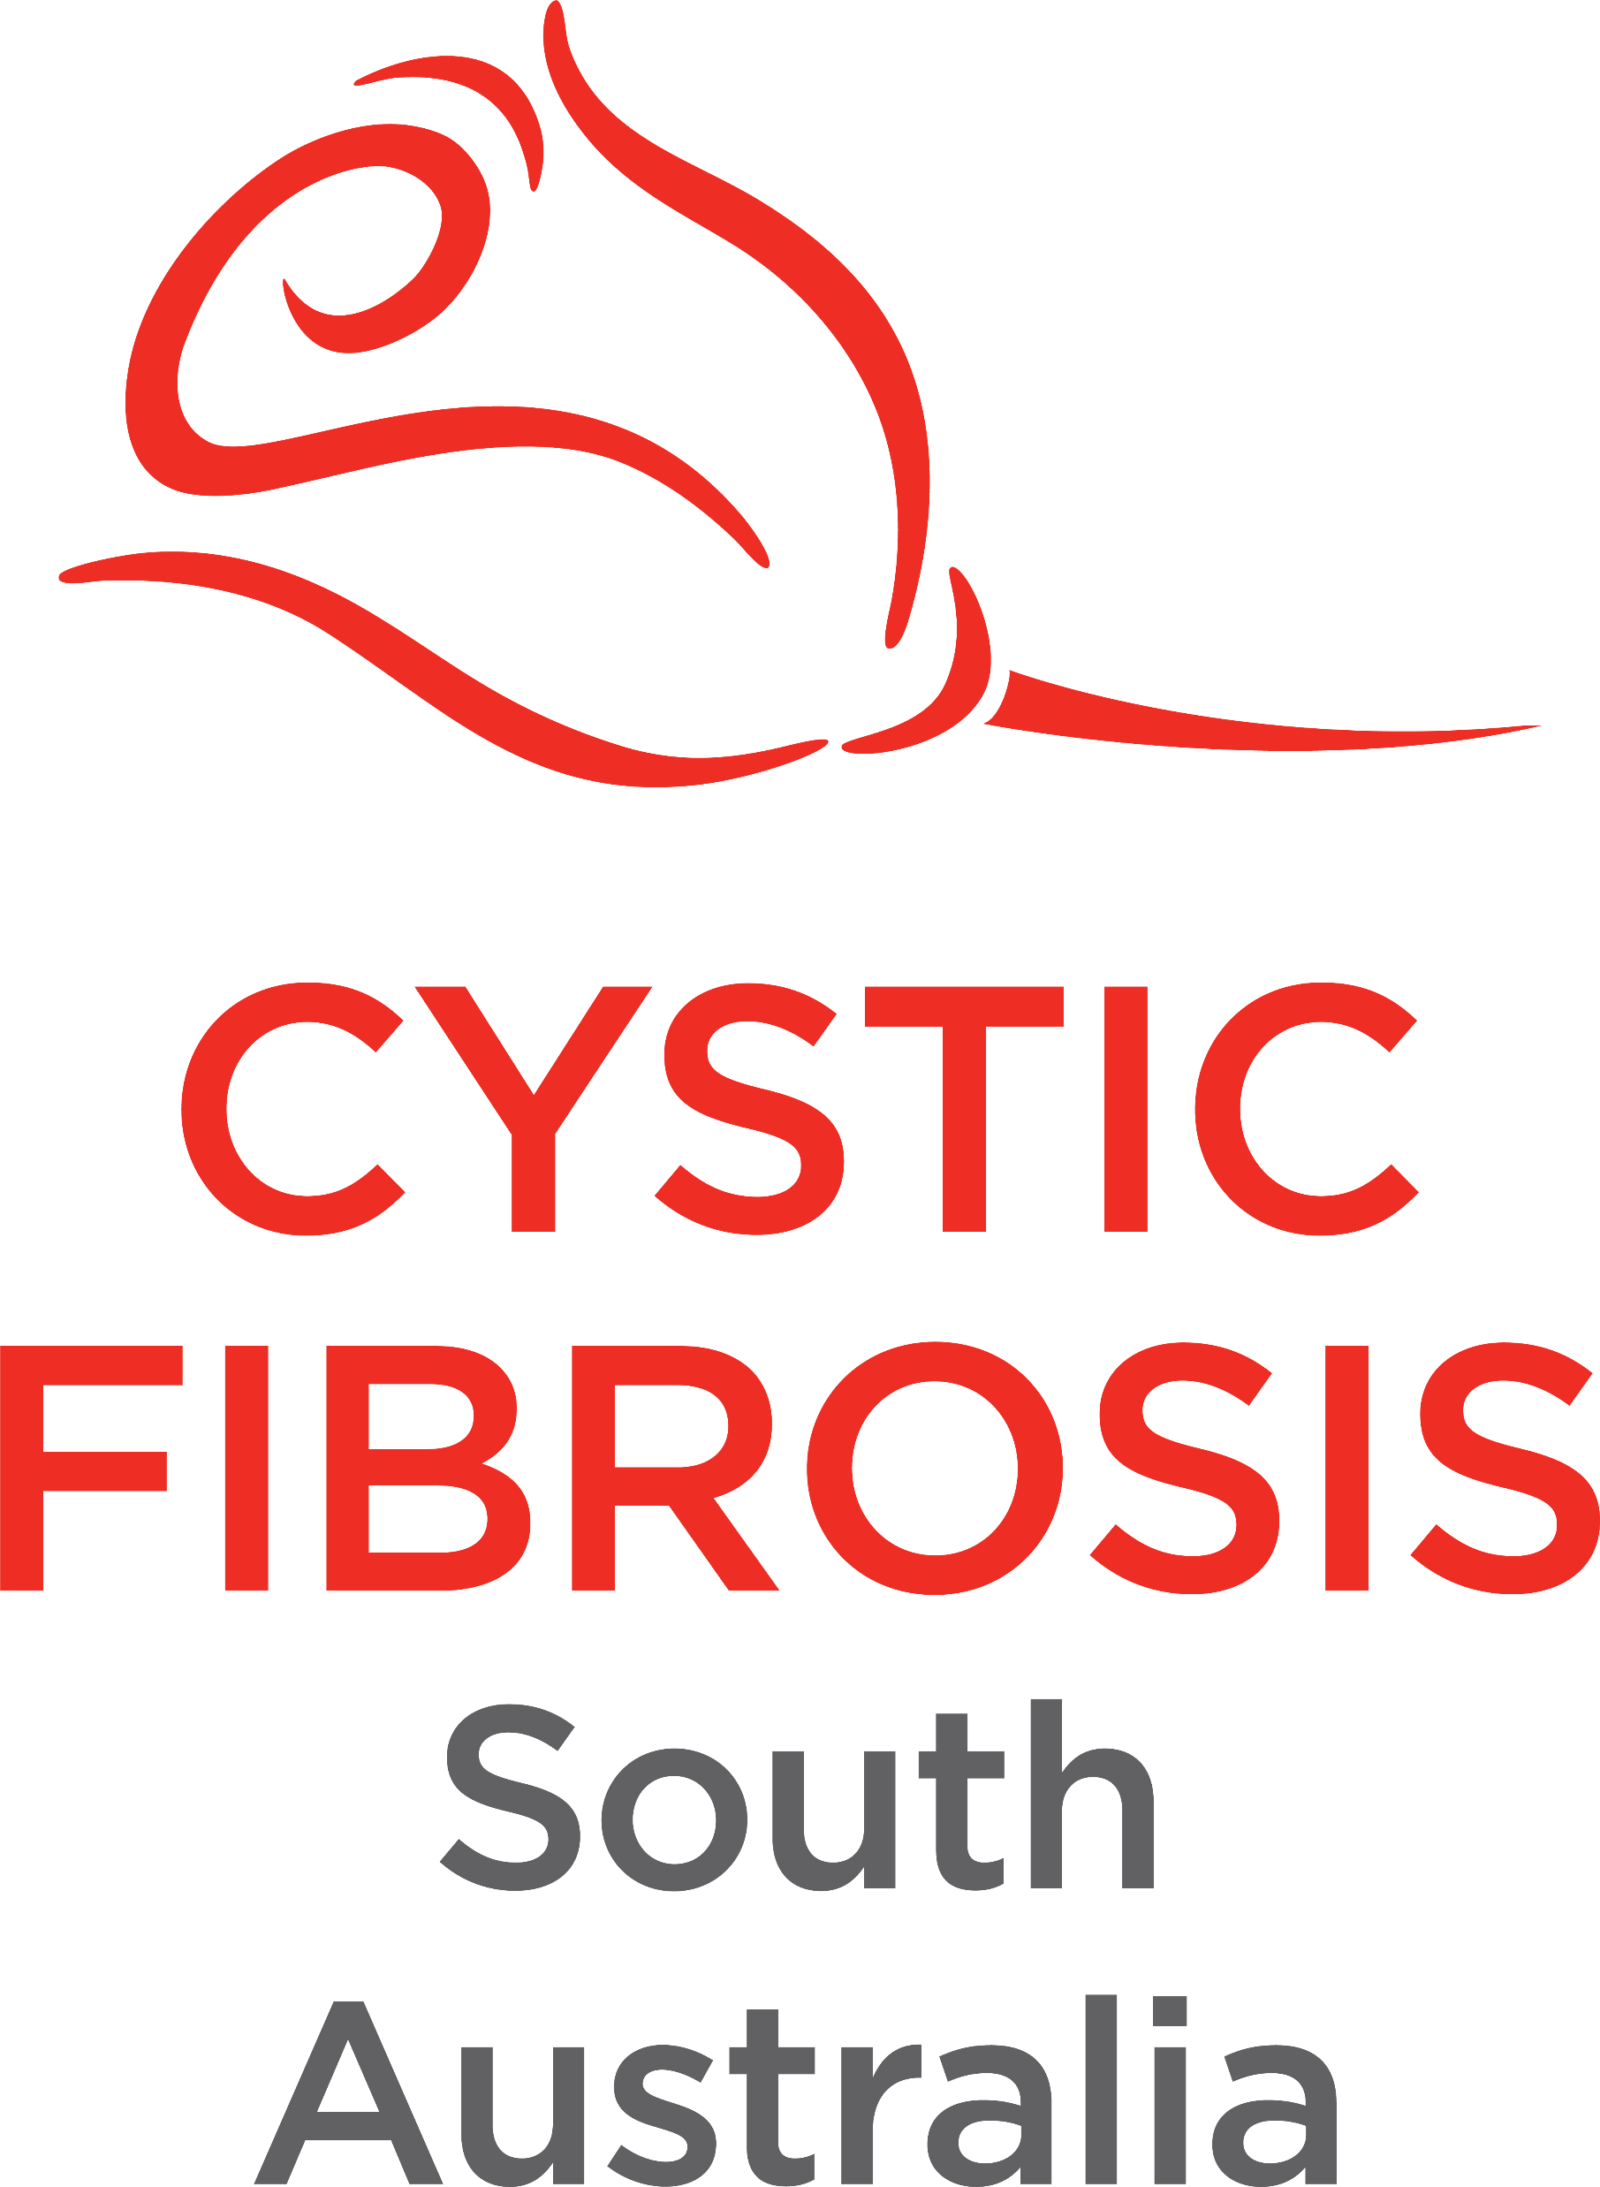
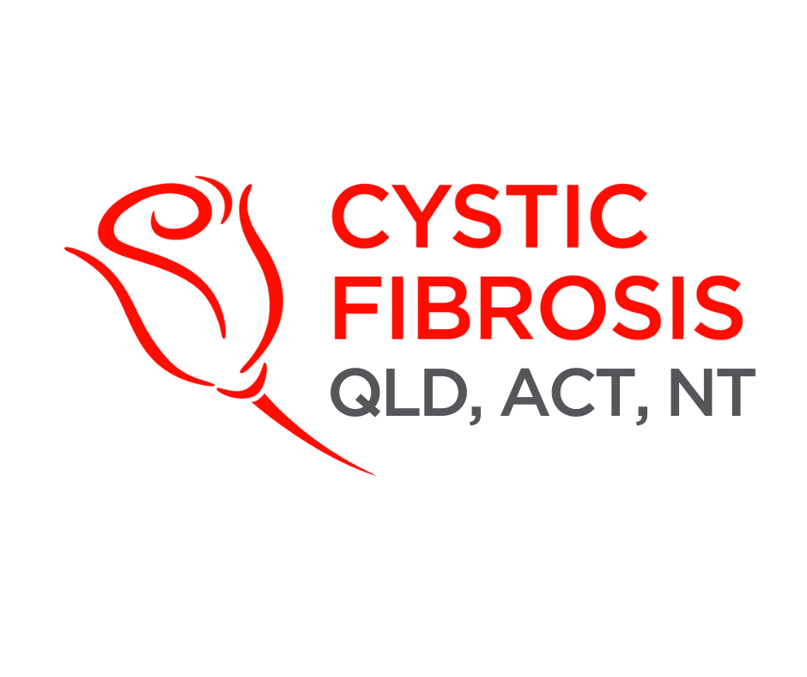
CF CAN
Module 2:
Understanding Cystic Fibrosis
Cystic Fibrosis Community Advocacy Network
Notes:
Module 2: Understanding Cystic Fibrosis
This module will equip you with the essential knowledge to understand cystic fibrosis, the genetic condition at the heart of our advocacy work. You will learn what causes cystic fibrosis, how it impacts the body, and the impact it has on daily life. We will also explore treatment advances, global and local statistics, and the role of social and health inequities in shaping outcomes.
By the end of this module, you will have a strong foundation to explain cystic fibrosis to different audiences and to advocate confidently for people living with the condition.

Slide 2

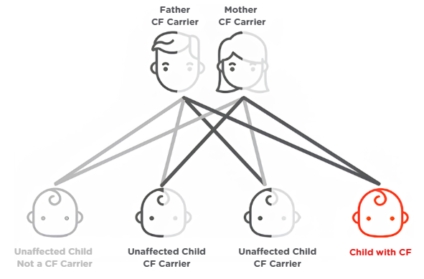
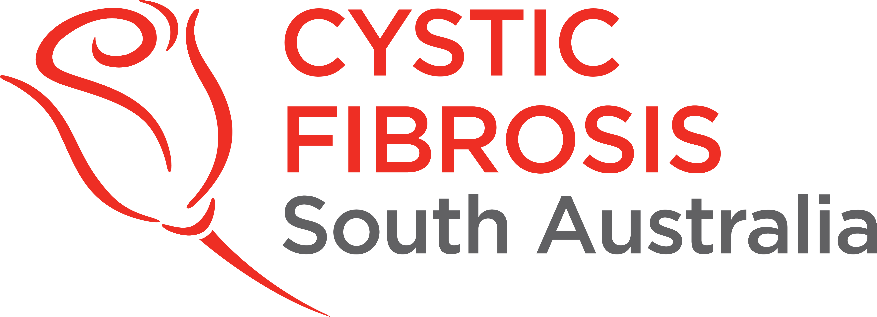
What is Cystic Fibrosis?
CFTR gene basics, mutation classes
Cystic fibrosis is a genetic condition caused by mutations in the CFTR gene.
Key
How is it inherited?
Normal CFTR gene
One faulty gene = carrier of cystic fibrosis
Mutated CFTR gene
Two faulty CFTR genes = cystic fibrosis
Notes:
Section 2.1: What is Cystic Fibrosis?
Cystic Fibrosis is a genetic condition caused by mutations in the CFTR gene.
A faulty CFTR protein causes > thick, sticky mucus > damage to lungs, digestive system, and other organs.
There are over 1,000 known mutations, with the most common being F508del
How is it inherited?
Two faulty CFTR genes = cystic fibrosis
One faulty gene = carrier of cystic fibrosis
Medical and technological advancements such as earlier screening, nutrition, modulators and transplants have extended life expectancy.

Slide 3

Daily Life with Cystic Fibrosis
Lungs & airways
Pancreas & digestion
Liver
Mucus blocks and damages airways
Recurrent infections
Risk of respiratory failure
Thick mucus blocks pancreatic ducts
Malnutrition, poor weight gain
CF-related diabetes (CFRD)
Mucus can obstruct bile ducts
Liver disease
Liver failure in severe cases
Bones and muscles
Kidneys
Malabsorption of vitamin D and chronic inflammation
Low bone density (osteoporosis)
Muscle weakness and fatigue
Long term use of antibiotics can damage the kidneys
Risk of kidney stones and dehydration
Reproductive system
Mental health & wellbeing
Other complications
98% of men are infertile
Women have thicker cervical mucus
Treatment burden (2-3 hours/day)
Frequent hospital admissions
Anxiety and depression are common
Higher risk of digestive cancers
Bladder incontinence
Salt loss syndrome
Notes:
Section 2.2: Daily Life with CF
People with cystic fibrosis can have few or no symptoms, while others experience severe or life-threatening complications.
Quality of life and survival depend on understanding how cystic fibrosis affects health, and taking steps to avoid further complications
How does cystic fibrosis affect your health?
Lungs and Airways
Mucus blocks and damages airways, causing chronic cough, wheeze, and breathlessness.
Recurrent infections (e.g., Pseudomonas aeruginosa, Staphylococcus aureus) → inflammation, scarring, and bronchiectasis.
Over time: loss of lung function, pulmonary exacerbations, risk of respiratory failure and lung transplantation.
Pancreas and Digestion
Thick mucus blocks pancreatic ducts → enzymes don’t reach the gut.
Results: malnutrition, poor weight gain, fat-soluble vitamin deficiencies.
CF-related diabetes (CFRD) develops in ~50% of adults with cystic fibrosis.
Symptoms: abdominal pain, bloating, greasy stools, fatigue.
Liver
Mucus can obstruct bile ducts → liver disease (steatosis, cirrhosis, portal hypertension).
Severe cases: liver failure → transplant.
Bones & Muscles
Malabsorption of vitamin D and chronic inflammation → low bone density (osteoporosis), fractures, and joint pain.
Muscle weakness and fatigue are common, making daily life and physical activity more difficult.
Kidneys
Long-term use of strong antibiotics (e.g., aminoglycosides) can damage the kidneys.
Kidney stones and dehydration (salt loss syndrome) are also risks.
Reproductive System
Men: ~98% infertile due to congenital absence of the vas deferens.
Women: Thicker cervical mucus makes conception more difficult; some may need fertility support.
Mental Health and Wellbeing
Treatment burden = 2–3 hours/day of medications, physio, and nebulisers.
Frequent hospital admissions → disrupted school, work, and social life.
Anxiety and depression are common, often linked to uncertainty about health and future.
Other Complications
Increased risk of digestive cancers (especially bowel cancer after age 40).
Bladder incontinence from chronic coughing.
Salt loss syndrome (especially in hot weather) → dehydration and electrolyte imbalance.
Medication load is heavy:
CFTR modulators
in 2024, 82.8% of people with cystic fibrosis were taking a CFTR modulator, but most still required airway clearance, antibiotics, and enzymes.
Antibiotics
Enzymes
Vitamins
Airway clearance
Monitoring
Lung function
Blood sugar
Imaging
Cultures
Cancer Screening
Treatment burden: Most people still spend 2–3 hours/day on therapies (airway clearance, medications, enzymes, physiotherapy).
Mental health: In 2024, only about 1 in 4 Australians with cystic fibrosis aged 12+ had a documented mental health review, despite high rates of anxiety and depression.
Nutrition: The median BMI for adults with CF in 2024 was 23.8 kg/m², slightly below the target for optimal outcomes.
Infections: Chronic Pseudomonas aeruginosa infection fell to 21.5% of people with CF in 2024 — one of the lowest rates ever reported, reflecting the impact of modulators and improved infection control.
Let’s take a look at how living with CF affects daily life.
^ ANNUAL REPORT 2024
Case Study: A Day in Thalia’s Life
Thalia, 16 years old, living with cystic fibrosis
Thalia wakes up an hour earlier than her classmates to complete airway clearance therapy and takes a mix of medications – including antibiotics, pancreatic enzymes with breakfast, and vitamins.
She often misses classes due to frequent clinic visits (every 6-8 weeks) and occasional hospital stay for lung infections. At school, Emily sometimes feels self-conscious and embarrassed when she coughs a lot in class and avoids playing sports when she is fatigued even though she loves playing volleyball.
Thalia struggles with the feeling of being “different”. Friends don’t always understand why she can’t just join spontaneous activities like sleepovers or going to the public pool because of her treatments or infection-control concerns.
The burden of constant treatment and fear of long-term complications often makes her feel anxious and isolated. She was meeting with a psychologist through the hospital under a GP appointed Mental Health Care Plan but hasn’t been going recently due to her sessions running out.
Thalia is hopeful because she has recently started on Trikafta, which has improved her lung function and energy levels. However, she and her family worry about the long-term costs and access to new therapies if Pharmaceutical Benefits Scheme (PBS) eligibility changes.
Discussion Prompts
What barriers to living a ‘normal’ teenage life do you see for Thalia?
If you were advocating on her behalf, what issues would you raise with decision-makers?

Slide 4
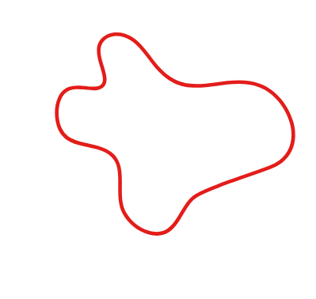
Access to Therapies
Pharmaceutical Benefits Scheme (PBS)
The PBS listing of Trikafta has been a major milestone for Australians with cystic fibrosis.
PBS access means most people with a CFTR mutation responsive to Trikafta can now access the drug at an affordable price.
However, barriers still remain.
Disparities in access to modulators, transplants, trials
Geographic Location
Socioeconomic
Emerging Therapies
Mental Health
Notes:
Section 2.3: Access to Therapies
Pharmaceutical Benefits Scheme (PBS)
The PBS listing of Trikafta has been a major milestone for Australians with cystic fibrosis.
Without subsidy, the annual cost is over $250,000 per patient.
PBS access means most people with a CFTR mutation responsive to Trikafta can now access the drug at an affordable price.
However, barriers remain:
People with rare mutations may not yet be eligible.
Rural families may struggle to attend regular monitoring appointments required to stay on therapy.
Administrative delays can leave families uncertain about access during transitions.
Physiotherapy and Standard Therapies
Daily airway clearance and physiotherapy remain essential even with modulators.
Access to physiotherapists and specialised cystic fibrosis exercise programs varies widely.
Barriers:
Families in regional areas may rely on telehealth with limited hands-on support.
Out-of-pocket costs for physiotherapy or exercise physiology services can be high if not fully covered by Medicare or NDIS.
Advocacy priority: strengthen funding for allied health, expand telehealth models, and ensure equitable access to rehabilitation.
Lung and liver transplants remain lifesaving, but access varies depending on state, transplant centre availability and suitability.
Participation in clinical trials gives early access to treatments, but opportunities are limited by geography and eligibility.
Disparities in Access
Geographic Location: People in rural/remote areas face long travel times, limited cystic fibrosis specialists, fewer transplant centres, and higher out-of-pocket costs.
Socioeconomic factors – lost wages from hospital stays, cost of travel/accommodation, and higher baseline living costs.
Mental Health – complex daily treatment and uncertainty affect adherence and outcomes, but mental health services are unevenly available.
Emerging Therapies – Gene therapies and personalised medicine are on the horizon, but equitable access is not guaranteed
National standards of care

Slide 5
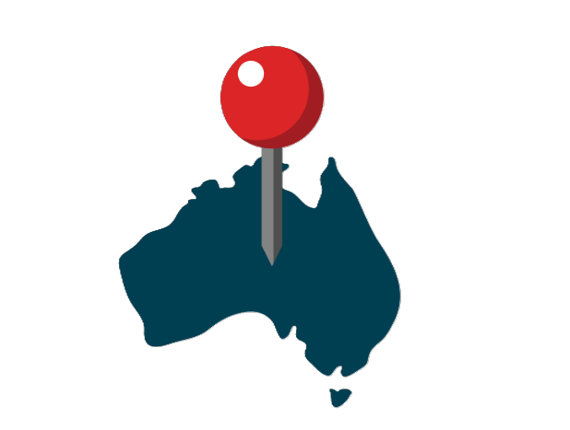
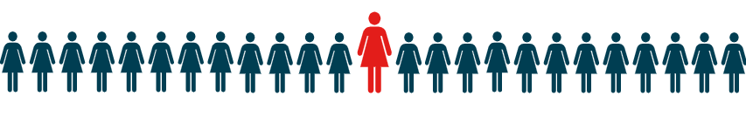
Global and Local Statistics
Australia
Registry Data
(ACFDR, 2024)
Almost 3,800 Australians are currently living with cystic fibrosis.
64
Predicted survival age for babies with cystic fibrosis born between 2019–2023
About 1 in 25 Australians carry the recessive cystic fibrosis gene
30.3%
Percent of people with CF in Australia aged 30 years and older with CFRD
82.8%
Percent of people with cystic fibrosis in Australia on a CFTR modulator by 2024
Regional Gaps within Australia
Variation in outcomes
Geography
Lung function (FEV1) for adults averages ~79%, but results vary across centres and states.
People in NT, TAS, and ACT often rely on interstate hospitals for specialist care.
The tyranny of distance
Mental health support
Our members can travel up to 3,423 km (NT to QLD) to access specialist CF care. Rural and remote communities face longer travel, fewer CF specialists and transplant centres, and higher out-of-pocket costs.
Around 1 in 4 people aged 12+ had a documented mental health review in 2024, despite high rates of anxiety and depression (ACFDR, 2024).
Notes:
Section 2.4: Statistics: survival rates, regional gaps
Australia (Local Context)
Population: Around 3,800 Australians are currently living with cystic fibrosis, and 58% are now adults, reflecting improved survival and ageing of the population.
Genetics: About 1 in 25 Australians carries the cystic fibrosis gene change; ~90% of people with cystic fibrosis have at least one F508del mutation.
Survival:
Median predicted survival age for babies born between 2019–2023 is 64 years, up from less than 10 years in the 1960s.
30.3% of people with cystic fibrosis in Australia aged 30 years and older had CFRD in 2024.
Treatment access: 82.8% of people with cystic fibrosis in Australia were on a CFTR modulator by 2024. Whilst these modulators offer numerous benefits in supressing cystic fibrosis symptoms, there is still no cure for cystic fibrosis.
Distribution: NSW and QLD have the largest cystic fibrosis populations, while NT and ACT have the smallest.
Regional Gaps Within Australia
Geography: People in NT, TAS, and ACT often rely on interstate hospitals for specialist care. Families in rural/remote areas face long travel times, high costs, and limited access to multidisciplinary teams.
Availability of Quality Care: Some CF centres are under-resourced, with shortages in specialised staff like CF dietitians, psychologists, and social workers.
Variation in outcomes: Lung function (FEV1) for adults averages ~79%, but results vary across centres and states.
Mental health support: Almost 1 in 4 people aged 12+ had a documented mental health review in 2024, despite high rates of anxiety and depression.
Rural, regional and remote: The Tyranny of Distance: Our members can travel up to 3,423 km (NT to QLD) to access specialist CF care. Rural and remote communities face longer travel, fewer CF specialists and transplant centres, and higher out-of-pocket costs.
(Taken from the Australian Cystic Fibrosis Data Registry – Annual Report 2024)

Slide 6



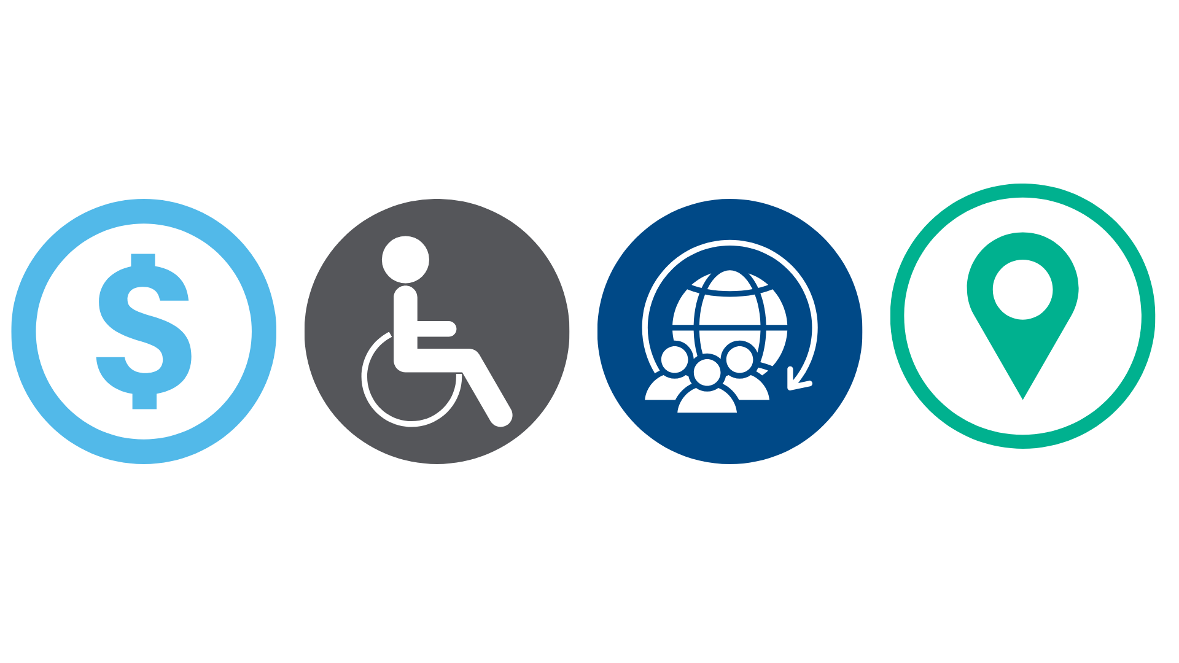
Intersectionality in Cystic Fibrosis Care
Understanding the bigger picture
Cystic Fibrosis outcomes are shaped by social determinants of health and intersecting identities
Income
Location
Disability
Culture and language
Notes:
Section 2.5: Intersectionality in Cystic Fibrosis care: Understanding the Bigger Picture
Cystic Fibrosis outcomes are shaped by social determinants of health and intersecting identities
Income – Families with low income may struggle with cost of travel, time off work, out-of-pocket medications, or healthy nutrition.
Location – Rural and remote families face fewer cystic fibrosis clinics, less access to transplants, and higher travel burdens.
Disability – People with cystic fibrosis may also live with co-morbidities (e.g., diabetes, osteoporosis) or disability, which compounds barriers.
Culture & Language – Culturally and linguistically diverse (CALD) families may face health literacy challenges or cultural barriers in engaging with the healthcare system
Equity in practice: CFQ provided over $100,000 in direct financial assistance in 2023–24 for medical expenses, activity subsidies, and equipment, helping reduce inequities for families.
Real-world examples
Can you identify what barriers these individuals face and how it can impact their ability to access treatment?
Jack, 19, lives in regional Queensland. He is eligible for Trikafta, but the nearest cystic fibrosis clinic is 7 hours away. His family drives long distances for monitoring appointments, often missing work and school.
Amira, 28, lives in Brisbane and is on Trikafta. While the PBS covers most of the drug cost, she still pays for frequent hospital parking, missed wages, and extra supplements not covered by subsidies. These costs add up and make it hard to keep up with treatment and she has had to work two jobs to pay for it.
Linh’s parents migrated from Vietnam and speak limited English. Linh, 14, has cystic fibrosis and her parents often struggle to understand medical instructions or apply for subsidies. This has led to confusion with booking appointments and communication about medications.
Mark, 35, has cystic fibrosis and cystic fibrosis-related diabetes. Managing both conditions requires multiple specialists. Limited coordination between services leads to delay in getting the right therapies

Slide 7


Slide 8

Notes:
https://forms.office.com/Pages/ResponsePage.aspx?id=yEdGupeeUUeAGk3aOs9mfr6xi9LyElFJmcdWLy1o6odUNVpUOENPQjZRTU05Uk8zS1pLOVNIVUdLQy4u

