Slide 1

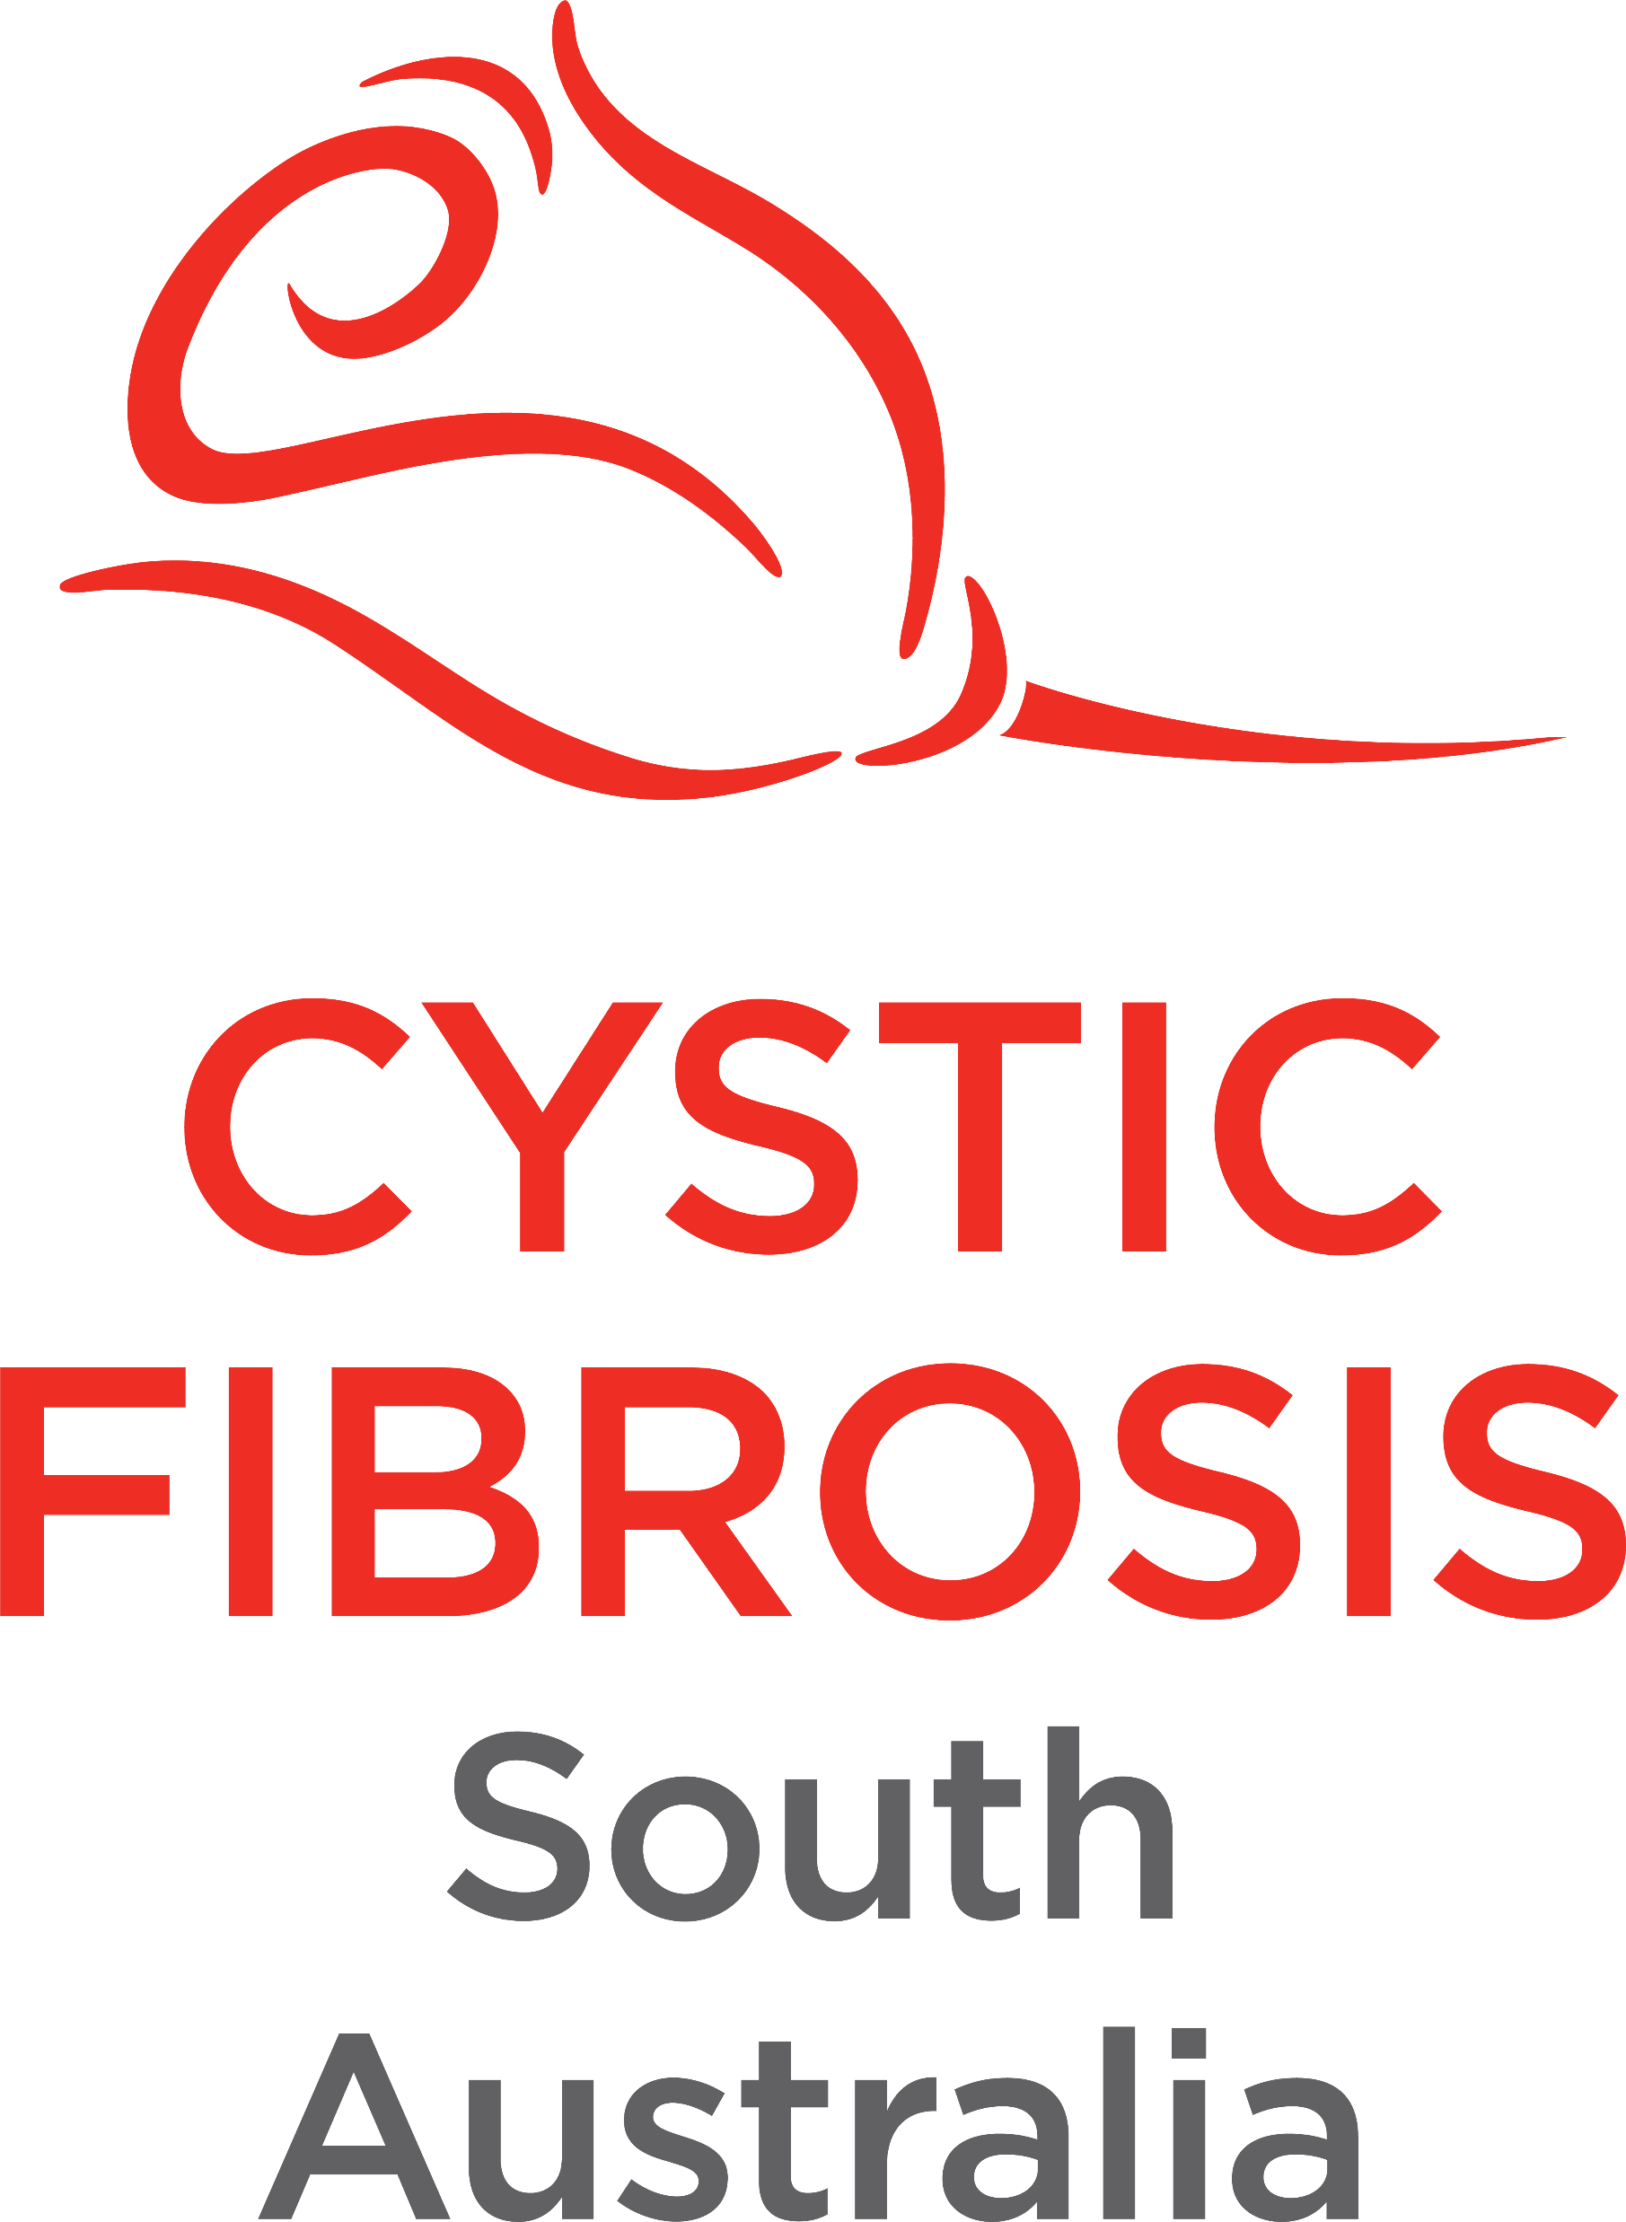
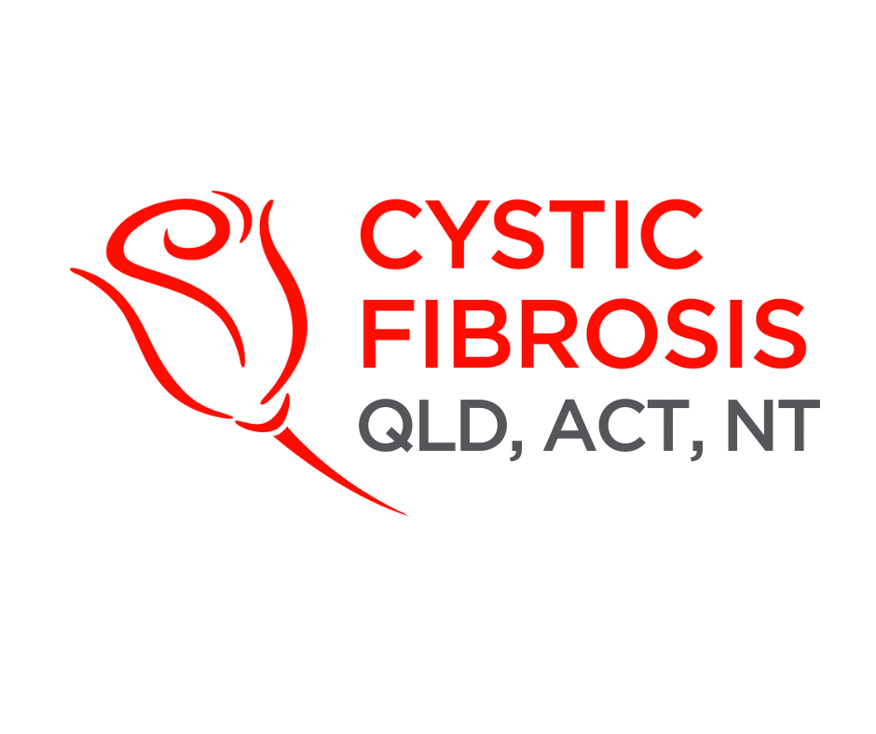
CF CAN
Module 3:
Becoming an Advocate
Cystic Fibrosis Community Advocacy Network
Notes:
Module 3: Becoming an Advocate

Slide 2
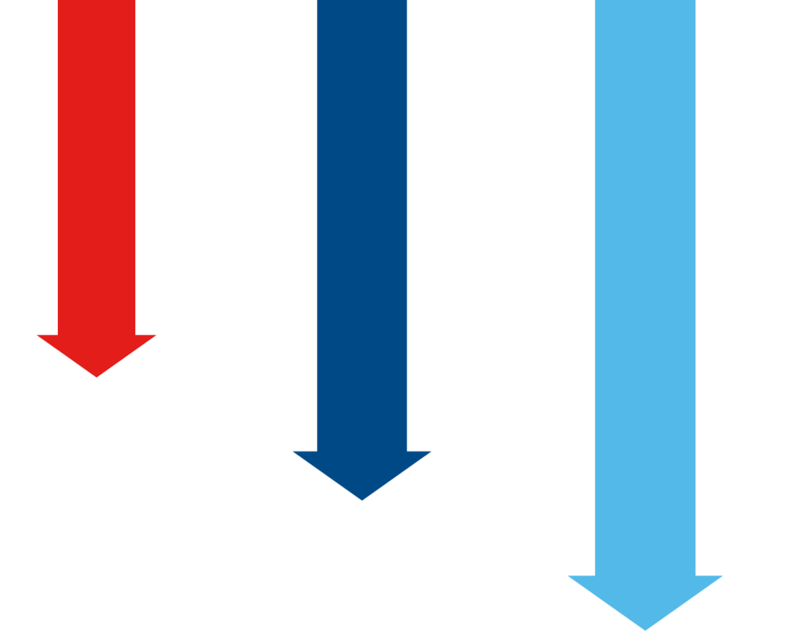

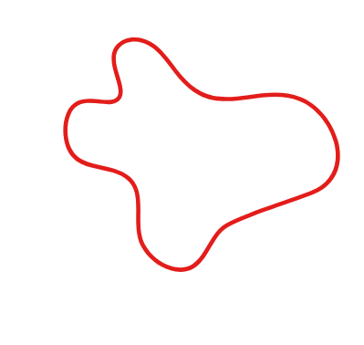


Stepping into Advocacy
1
Self advocacy
Standing up for your own care needs.
Advocacy can be:
Personal (speaking up for your own needs)
Community-based (working together with others)
2
Community advocacy
Working together with peers and support networks.
Systemic (influencing health policy and laws).
There is no single “right” way to advocate.
3
Policy/system advocacy
Engaging with government, health services and organisations to change systems.
Notes:
Module 3: Becoming an Advocate
Section 3.1 – Stepping into Advocacy
Advocacy begins with recognising that your experiences, insights, and perspectives have value. Every person connected to cystic fibrosis — whether living with the condition, a carer, or a supporter — has the power to influence change.
Advocacy can be personal (speaking up for your own needs), community-based (working together with others), or systemic (influencing health policy and laws).
There is no single “right” way to advocate — it may be as small as asking a doctor a question, or as large as speaking to Parliament.
Know your audience: Start by asking participants to introduce themselves and share one reason they joined CF CAN. This helps you understand their motivations and tailor the session to their needs.
Engagement Prompt: “Think about a time you spoke up for yourself or someone else. What difference did it make?”

Slide 3

What is Patient Advocacy?
Levels of advocacy
Policymakers and clinicians rely on data, but stories bring numbers to life.
1
Self advocacy
Lived experience helps decision-makers understand the real impact of policies and treatments.
Standing up for your own care needs.
2
Community advocacy
Working together with peers and support networks.
3
Policy/system advocacy
Engaging with government, health services and organisations to change systems.
Notes:
Section 3.2 – What is Patient Advocacy?
Patient advocacy is the practice of supporting, promoting, and defending a patient’s rights, needs, and interests within the complex healthcare system.
Advocacy has multiple levels, from personal advocacy to systems-level advocacy, starting small helps people build skills and confidence before stepping into to larger, more intimidating spaces. CF CAN provides structure and resources to scaffold this progression.
In the CF context, this means:
Ensuring people with cystic fibrosis have equitable access to therapies, trials, and specialist care.
Amplifying lived experience to influence decision-making.
Reducing barriers linked to geography, income, or cultural background.
Levels of Advocacy:
Self-advocacy: Standing up for your own care needs.
Community advocacy: Working together with peers and support networks.
Policy/system advocacy: Engaging with government, health services, and organisations to change systems.
Interactive Idea: Give examples (e.g., “asking for a referral to a psychologist,” “writing to an MP about PBS coverage”) and ask participants to identify which level of advocacy it fits.

Slide 4

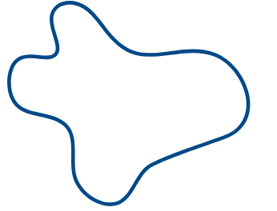
Storytelling
Lobbying
Everyday advocacy
Community action
Advisory roles
Why Your Voice Matters
Policymakers and clinicians rely on data, but stories bring numbers to life.
Lived experience helps decision-makers understand the real impact of policies and treatments.
Notes:
Section 3.3 – Why Your Voice Matters
Policymakers and clinicians rely on data, but stories bring numbers to life.
Lived experience helps decision-makers understand the real impact of policies and treatments.
The cystic fibrosis community has already influenced change — for example, advocacy was key in securing PBS listing for Trikafta.
Encourage participation: Invite volunteers to share one sentence about why they think advocacy matters. Validate every contribution to build trust.

Slide 5
Ways to Advocate
There are many forms of advocacy, each equally valuable:
Storytelling
Lobbying
Everyday advocacy
Advisory roles
Community action
Notes:
Section 3.4 – Ways to Advocate
There are many forms of advocacy, each equally valuable:
Storytelling: Sharing lived experiences at events, in the media, or online.
Lobbying: Writing letters, signing petitions, or meeting MPs.
Community action: Organising awareness events, fundraisers, or campaigns.
Advisory roles: Serving on hospital committees or community boards.
Everyday advocacy: Speaking up in appointments, requesting services, or helping peers navigate the system.
Interactive Prompt: “Which type of advocacy feels most comfortable to you right now? Which feels most challenging?”
Adapt to feedback: Use a live poll (e.g., Mentimeter, Kahoot) to ask which method participants feel most comfortable with. If many choose “storytelling,” adjust activities to focus more on this.

Slide 6
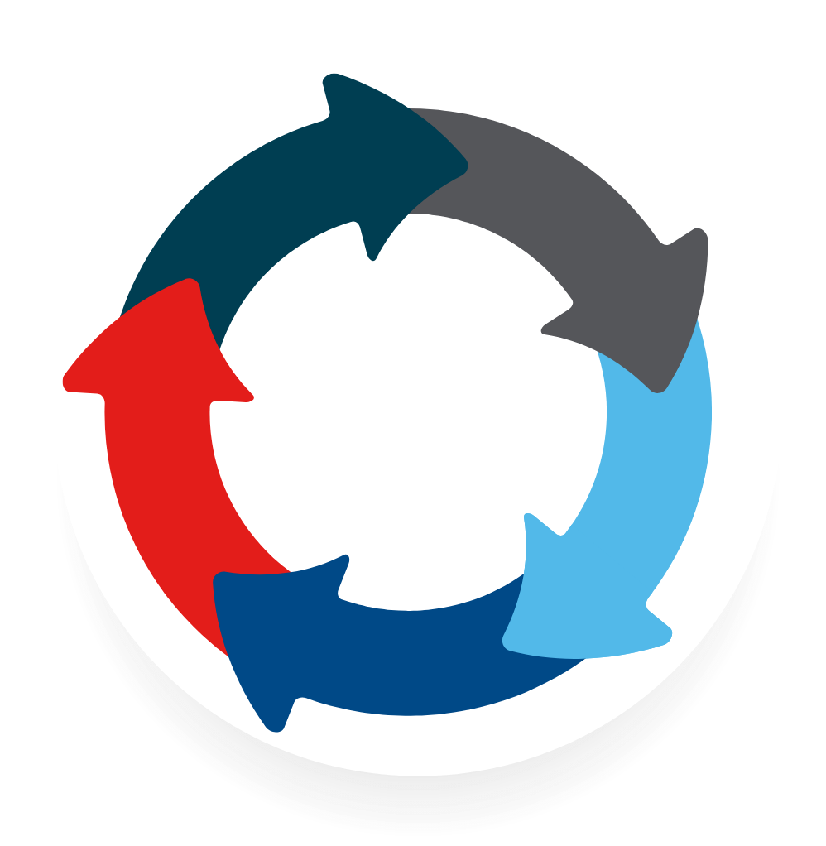
How to Start
Steps for new advocates:
1
2
3
4
5
Identify
Choose
Set
Start
Build
your motivation
an advocacy issue
a SMART goal
small
confidence through practice & peer support
SMART goal:
S
M
A
R
T
pecific
easurable
chievable
elevant
ime-bound
Notes:
Section 3.5 – How to start
Steps for new advocates:
Identify your motivation – what issue drives you to act?
Choose an advocacy issue (access, equity, awareness, support).
Set a SMART goal – specific, measurable, achievable, relevant, time-bound.
Start small – one email, one meeting, one story.
Build confidence through practice and peer support.
SMART Goal Example
Specific: I want to advocate for faster access to new CFTR modulators for people with rare CF mutations.
Measurable: I will write a submission to my local MP that includes at least two personal stories and recent survival statistics from the CF Data Registry.
Achievable: I will use the CF CAN advocacy toolkit and work with my local cystic fibrosis support group to collect stories and data.
Relevant: Many Australians with rare mutations still cannot benefit from current PBS-listed modulators, creating inequities in survival and quality of life.
Time-bound: I will complete and send the submission within the next three months.
Case Example:
1. Identify your motivation
Sophie, a 22-year-old living with cystic fibrosis, feels strongly about the lack of mental health support in cystic fibrosis care. She knows many young people in the community who struggle with anxiety and depression but don’t receive regular psychological reviews.
2. Choose an advocacy issue
Sophie decides her focus will be improving access to mental health services for people with cystic fibrosis.
3. Set a SMART goal
Sophie writes: “By the end of this year, I will contact my local MP and share my lived experience to advocate for more funding for mental health support in cystic fibrosis specialist clinics.”
4. Start small
Her first step is to draft a short letter describing her experience and the gaps she sees. She asks a peer from the cystic fibrosis community to review it before sending.
5. Build confidence
Sophie joins a CF CAN workshop to practice storytelling and advocacy messaging. When she meets with her MP, she feels prepared and supported.
Now it’s your turn. Activity Idea: Provide a SMART goal template, then have participants write down one advocacy issue they care about and one small step they could take in the next month.

Slide 7


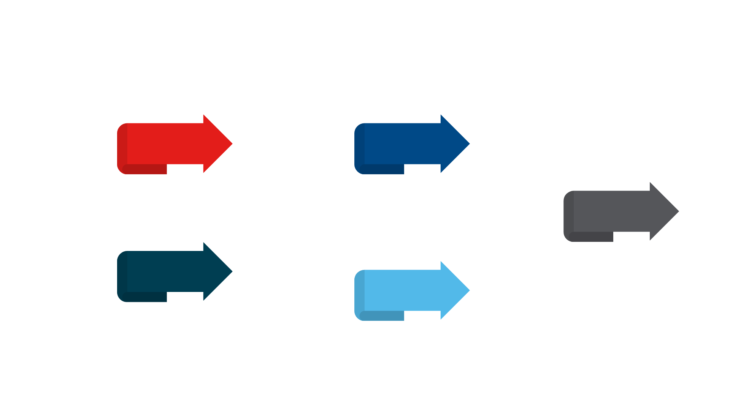
Ethical Considerations
Effective advocacy requires responsibility:
Speak with not for
Make space for diverse voices; don’t assume your story represents all.
Confidentiality
Only share your own story unless you have permission.
Respect
Use inclusive language, honour differences in experience, and engage with empathy.
Accuracy
Balance lived experience with reliable data.
Professionalism
Even when frustrated, advocacy should be constructive and solution-focused.

Slide 8

Notes:
Wrap up
Follow up and follow through: End by asking each participant to write one advocacy action they’ll commit to. Follow up a month later with an email or peer group check-in to share progress and celebrate wins

Slide 9

Notes:
https://forms.office.com/Pages/ResponsePage.aspx?id=yEdGupeeUUeAGk3aOs9mfr6xi9LyElFJmcdWLy1o6odUNVRBRVg4MjFDM0VFOTM5TDkzOFJVREhBVS4u

