Slide 1



CF CAN
Module 4:
Communication Skills for Advocacy
Cystic Fibrosis Community Advocacy Network
Notes:
Module 4: Communication Skills for Advocacy
Communication is at the heart of advocacy. The most powerful policies, programs, and reforms often begin with just one person sharing their story in a way that resonates with others. This module will help you develop practical communication skills, from telling your story, to writing persuasive letters, to engaging with media, so you can amplify your voice and drive change

Slide 2

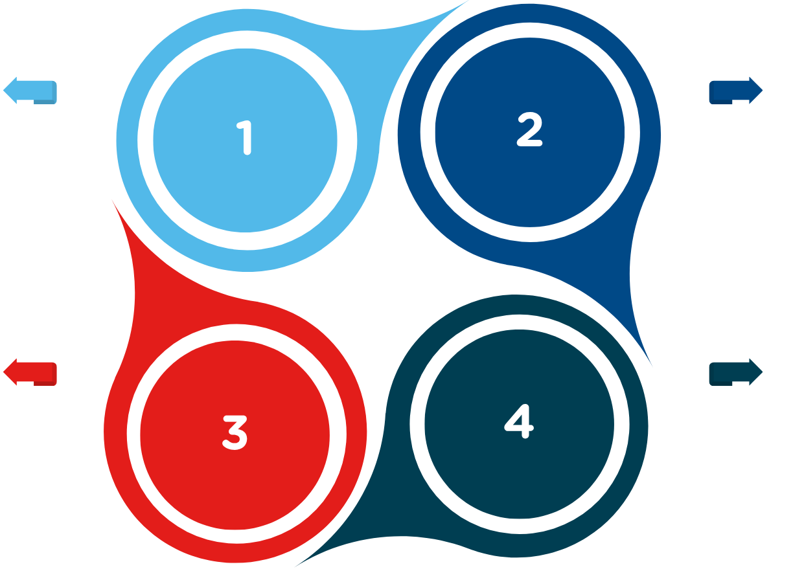


Mastering Communication
Four foundations of advocacy communication
Clarity
Keep your message simple and focused.
Authenticity
Speak from lived experience; it’s your greatest strength.
Audience awareness
Adapt your message for who you are speaking to (clinicians vs. policymaker vs. public)
Confidence
Believe that your story matters – because it does.
Notes:
Section 4.1 – Mastering Communication
Fostering positive emotions
Customise the message so that it resonates with underlying values and interests
Include specific calls to action
Successful advocacy depends on important messages being communicated and heard. https://www.share4rare.org/library/share4rare-toolkit-patient-advocacy/developing-your-strategy
https://www.ncbi.nlm.nih.gov/books/NBK310928/
Informative video:
Section 4.1 – Mastering Communication
Advocacy relies on clear and confident communication. You might have the most powerful story in the world, but if it isn’t shared in a way that people can hear, understand, and remember, the message can get lost.
Four Foundations of Advocacy Communication:
Clarity – Keep your message simple and focused.
Authenticity – Speak from lived experience; it’s your greatest strength.
Audience awareness – Adapt your message for who you are speaking to (clinician vs. policymaker vs. public).
Confidence – Believe that your story matters — because it does.
Mini-Activity: Spot the Difference
Facilitator reads two short advocacy statements aloud:
Example A: “The CFTR modulator drug has high efficacy and is currently subsidised through the PBS, but delays in access are still experienced for the 2–5-year-old cohort.”
Example B: “My son is four. He qualifies for Trikafta, but we waited months before he could start. Every week felt like a year.”
Ask participants: Which one is clearer? Which one is more likely to be remembered? Why?
Once we understand these foundations, the next step is learning how to frame and tell your own story so it makes an impact.

Slide 3
Telling your story
Four components of an advocacy story:
Who you are
The challenge
The turning point
The message
Notes:
Section 4.2 – Telling Your Story – Key Components + effective framing
Stories are one of the most powerful advocacy tools. While facts and figures convince the head, stories reach the heart and that’s often where decisions are truly made. Your lived experience is what makes CF advocacy unique and impossible to ignore.
The Four Key Components of an Advocacy Story:
Who you are – Introduce yourself and your connection to cystic fibrosis.
The challenge – Describe a barrier or struggle you’ve faced.
The turning point – What helped, or what could have helped?
The message – The change you want decision-makers to make.
DIY Activity: Build Your Story
Facilitator gives participants a simple template:
“My name is ___, and I am [your role/connection to cystic fibrosis].
One challenge I have faced is ___.
This changed when ___ (or it could have been different if ___).
That’s why I believe [insert clear message/ask].”
Example:
“My name is Sophie; I’m 22 and living with cystic fibrosis. One challenge I faced was being turned down for a clinical trial because of my postcode. If I had been able to participate, I could have accessed life-changing medication sooner. That’s why I believe every person with cystic fibrosis should have equal access to trials, no matter where they live.”
Pair & Share: Participants practice telling their story in pairs (90 seconds each). The listener gives one piece of feedback: “The part that stuck with me most was…”

Slide 4

1
Respectful and concise
2
Personal and evidence based
3
A clear ask
Public Speaking Tips
Four practical tips for public speaking:
Body language
Stand tall, keep an open posture, and use natural gestures. Avoid crossing your arms or looking down.
Tone
Speak warmly, with energy. Vary your tone to highlight important points – don’t stay monotone
Pacing
Slow down. Pauses help people absorb your words and make you sound more confident
Nerves
It’s normal to feel anxious. Focus on your message, not on being perfect. Deep breaths before speaking really help.
Hook
Lived experience
Evidence
Call to action
Start with something that grabs attention.
Share how cystic fibrosis impacts real lives.
Back it with data (registry stats, costs, survival rates).
Finish with what needs to change.
Notes:
Section 4.3 – Public Speaking Tips – Body language, tone, pacing
Sharing your story is powerful, but how you deliver it matters just as much as what you say. Public speaking doesn’t have to mean standing on a stage; it can be speaking in a clinic meeting, presenting to your MP, or even introducing yourself in a workshop.
Four Practical Tips for Public Speaking:
Body language – Stand tall, keep an open posture, and use natural gestures. Avoid crossing your arms or looking down.
Tone – Speak warmly, with energy. Vary your tone to highlight important points — don’t stay monotone.
Pacing – Slow down. Pauses help people absorb your words and make you sound more confident.
Nerves – It’s normal to feel anxious. Focus on your message, not on being perfect. Deep breaths before speaking really help.
Interactive Activity: One-Minute Advocacy Pitch
Each participant introduces themselves and states one advocacy goal in 30–60 seconds.
Example: “My name is James; I’m a carer for my daughter with cystic fibrosis. My advocacy goal is to improve access to hospital parking subsidies for families, because travel and parking costs add up quickly and create extra stress.”
Listeners give supportive feedback: “I liked your tone,” “Your message was clear,” “I could feel your passion.”

Slide 5
Writing Letters and Opinion Articles
Letters to MPs – 3 key ingredients:
1
Respectful and concise
2
Personal and evidence based
3
A clear ask
Op-Eds (opinion articles):
Hook
Lived experience
Evidence
Call to action
Start with something that grabs attention.
Share how cystic fibrosis impacts real lives.
Back it with data (registry stats, costs, survival rates).
Finish with what needs to change.
Facebook/ Instagram | Twitter | LinkedIn
Great for community stories, images, and awareness campaigns. | Best for quick updates, tagging MPs, journalists, and advocacy organisations. | Professional space for policy discussions, research, and building partnerships.
Notes:
Section 4.4 – Writing Letters and Op-Eds – Structure, Emotional hooks, sample templates
Sometimes your advocacy won’t be spoken it will be written. A well-crafted letter to an MP, or an opinion article in a local paper, can spark conversations and push decision-makers to act. Writing allows you to reach people you might never meet in person.
Letters to MPs – 3 Key Ingredients:
Respectful & concise – Keep it to one page.
Personal & evidence-based – Share your story, then add data or facts.
A clear ask – End with one action you want them to take (e.g., raise the issue in Parliament, support funding, attend a meeting).
Opinion Articles, or Op-Eds, short for opposite the editorial page:
Hook – Start with something that grabs attention (personal story, striking fact).
Lived experience – Share how cystic fibrosis impacts real lives.
Evidence – Back it with data (registry stats, costs, survival rates).
Call to action – Finish with what needs to change.
DIY Activity: Draft Your First Paragraph
Give participants this starter:
“Dear [MP name], my name is ___ and I am [your connection to cystic fibrosis]. One of the biggest challenges I face is ___. This impacts me/my family by ___. I am writing to ask you to support…”
Group Feedback: Invite volunteers to read their draft first paragraph. As a group, discuss: “What made this opening strong? What could make it more powerful?”
Using ChatGPT & Google Notebook LM to help advocates learn about how to write letters/emails/articles/posts
Creating a prompt for CF CAN to help advocates learn the tone, structure, and language used in advocacy efforts
“Help me write an advocacy letter to my local MP
Can assist non-English speakers, those with low health literacy, rural participants.
Can make exemplars

Slide 6
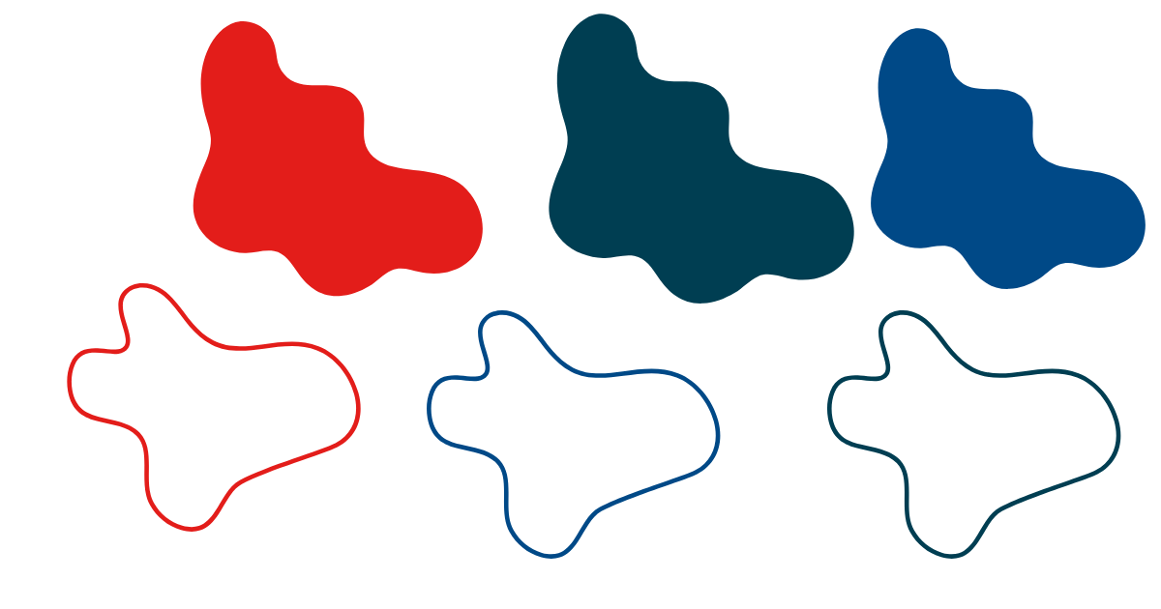

Using Social Media
Choosing the right platform:
Facebook/ Instagram | X | LinkedIn
Great for community stories, images, and awareness campaigns. | Best for quick updates, tagging MPs, journalists, and advocacy organisations. | Professional space for policy discussions, research, and building partnerships.
Prepare 2-3 key points before the interview – and repeat them often.
Keys to effective online advocacy:
Use sound bites – short, memorable sentences that stick.
Be authentic
Keep it simple
Use visuals
Bridge back to your message if asked tricky questions.
Stay respectful
Protect privacy
Stay respectful and solutions-focused – avoid negativity.
Practice calm delivery – short pauses give you control.
Notes:
Section 4.5 – Using social media – Platforms, messaging, shareability, avoiding pitfalls
Social media has become one of the most powerful advocacy tools. It lets you connect directly with the public, the media, and even policymakers often faster than traditional channels. A single post can raise awareness, rally support, or put pressure on decision-makers.
Choosing the Right Platform:
Facebook / Instagram: Great for community stories, images, and awareness campaigns.
X: Best for quick updates, tagging MPs, journalists, and advocacy organisations.
LinkedIn: Professional space for policy discussions, research, and building partnerships.
Keys to Effective Online Advocacy:
Be authentic – Share lived experience with honesty.
Keep it simple – Short, clear messages work best.
Use visuals – Images, videos, and infographics grab attention.
Stay respectful – Avoid online arguments; focus on solutions.
Protect privacy – Never share personal health details without consent.
Interactive Activity: Create a Post
Split participants into small groups.
Give each group an advocacy issue (e.g., access to modulators, mental health support, rural travel burden).
Each group drafts a sample post for a platform of their choice (Instagram, X, or LinkedIn).
Example (X):
“Families in rural QLD travel hours for cystic fibrosis care. Telehealth works — but funding must continue. Every person with CF deserves equal access, no matter where they live. #CFAwareness #HealthEquity”
Debrief: Ask each group to share their post. Discuss: Which ones would grab attention? Which ones clearly explained the issue?
Activity: Small groups draft a sample social media post for 65 Roses Day — one for Instagram, one for LinkedIn. Compare approaches.

Slide 7



Engaging with Media
Top tips for engaging with media:
Prepare 2-3 key points before the interview – and repeat them often.
Use sound bites – short, memorable sentences that stick.
Reflect back to your message if asked tricky questions.
Stay respectful and solutions-focused – avoid negativity.
Practice calm delivery – short pauses give you control.
Notes:
Section 4.6 – Engaging with Media – Interviews, Sound Bites, Message Discipline
Media interviews and stories can amplify your advocacy far beyond the cystic fibrosis community. A single news article or radio interview can influence public opinion — and catch the attention of policymakers. The key is to stay clear, confident, and on-message.
Top Tips for Engaging with Media:
Prepare 2–3 key points before the interview — and repeat them often.
Use sound bites — short, memorable sentences that stick.
Example: “Access to Trikafta means children with cystic fibrosis can dream about adulthood.”
Bridge back to your message if asked tricky questions.
Example: “That’s an important point, but what really matters is…”
Stay respectful and solutions-focused — avoid negativity.
Practice calm delivery — short pauses give you control.
Interactive Activity: Role-Play Interview
Pair participants. One is the journalist; one is the advocate.
The journalist asks: “Why should taxpayers fund expensive cystic fibrosis medicines?”
The advocate responds in 1–2 sentences, keeping it respectful and message-driven.
Debrief: Ask the group: What worked? What phrases stood out? How did the advocate stay on message?

Slide 8

www.cfqld.org.au
services@cfqld.org.au
07 3359 8000
Notes:
Facilitator Wrap-Up:
Communication takes many forms — telling your story, speaking publicly, writing letters, posting online, or engaging with media. The more you practice, the more confident you’ll feel. Remember: advocacy isn’t about being perfect — it’s about being authentic, focused, and clear.
Take-Home Challenge: Before the next module, draft either:
a 1-minute story,
a sample social media post, or
a first paragraph of a letter to your MP.
Bring it to the next session to share.

Slide 9

Notes:
https://forms.office.com/Pages/ResponsePage.aspx?id=yEdGupeeUUeAGk3aOs9mfr6xi9LyElFJmcdWLy1o6odUREZLVjdGT0pMRzRaQzM4UVkwSTNBOVgyTy4u

