Slide 1


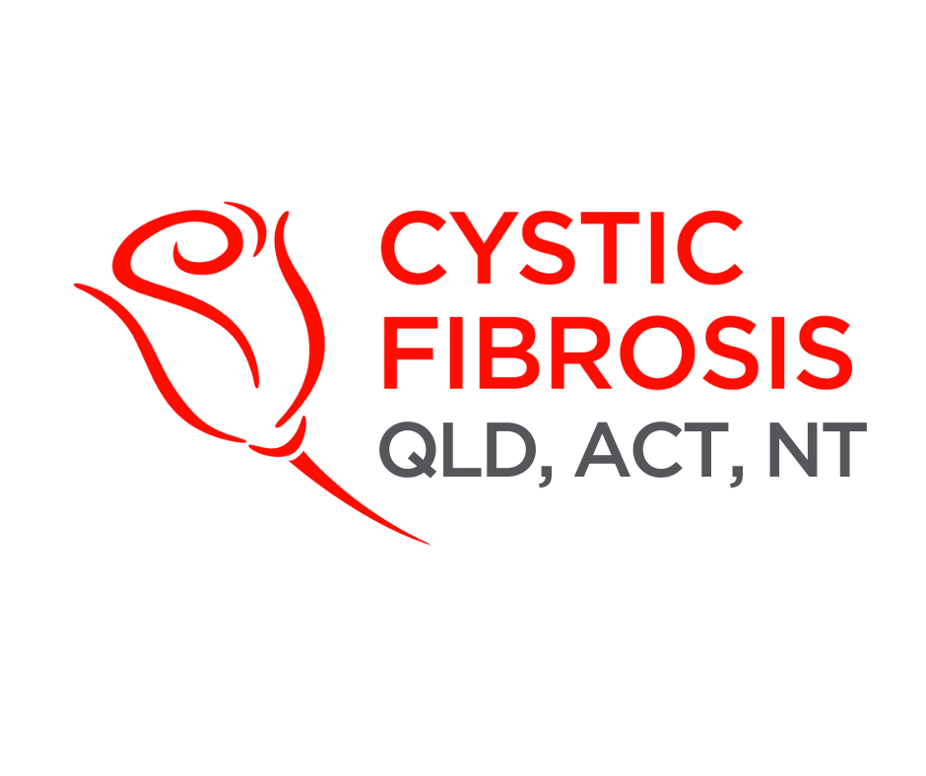
CF CAN
Module 5:
Navigating Health Systems and Policy
Cystic Fibrosis Community Advocacy Network
Notes:
Module 5: Navigating Health Systems and Policy

Slide 2


Informed consent:
You must be given clear, understandable information about treatments and make your own decision without pressure.
Privacy:
Protected by the Privacy Act 1988 – your health information is confidential and should only be shared with consent or in limited legal circumstances.
Understanding the System
Care is delivered through:
Financial aid service | What is it for? | More information
Medicare Safety Net | Provides higher Medicare rebates for people who have high out-of-pocket costs for out-of-hospital medical services in a calendar year. | https://www.servicesaustralia.gov.au/medicare-safety-nets
National Disability Insurance Scheme (NDIS) | People with severe cystic fibrosis related disability may access supports. | https://www.cfqld.org.au/cystic-fibrosis-trusted-care/
Trusted Care | Subsidiary of Cystic Fibrosis Queensland, NDIS provider. | https://www.trustedcare.org.au/
Centrelink | Payments such as Carer’s Allowance or Disability Support Pension may help families where caring for a child with cystic fibrosis prevents full-time employment, or if an adult with cystic fibrosis is not able to work. | https://www.servicesaustralia.gov.au/carer-allowance https://www.servicesaustralia.gov.au/disability-support-pension
Hospital and state subsidies | Assists rural patients who must travel to Brisbane for cystic fibrosis clinics or transplant assessments. | https://www.qld.gov.au/health/services/travel/subsidies
Primary Care
General practitioners (GPs), allied health, community health centres
Secondary care
Specialist appointments, outpatient clinics.
Tertiary care
Hospitals, transplants centres, specialist cystic fibrosis services
Funding comes from:
Federal government
Medicare subsidises GP and specialist visits; the PBS subsidises medicines.
State governments
Fund public hospitals and specialist CF clinics.
Private health insurance
May cover additional physiotherapy, fertility services, or private hospital admissions.
Travel, parking, non-PBS medicines, and uncovered allied health services often fall onto patients and/or their families, with many relying on support from not-for-profit organisations to help manage these costs.
Out-of-pocket payments
Notes:
Module 5: Navigating Health Systems and Policy
Section 5.1: Understanding the System
Australia’s healthcare system is complex — part public, part private, and sometimes difficult to navigate. For people with cystic fibrosis, this complexity often creates barriers to timely care and financial support.
Care is delivered through:
Primary Care: General practitioners (GPs), allied health (e.g., physiotherapists, dietitians), community health centres
Secondary care: Specialist appointments, outpatient clinics.
Tertiary care: Hospitals, transplants centres, specialist cystic fibrosis services
Funding comes:
Federal government: Medicare subsidises GP and specialist visits; the PBS subsidises medicines such as Trikafta
State governments: Fund public hospitals and specialist CF clinics.
Private health insurance: May cover additional physiotherapy, fertility services, or private hospital admissions.
Out-of-pocket payments: Travel, parking, non-PBS medicines, and uncovered allied health services often fall onto patients and/or their families.
Interactive prompt: “Think about your own or your family’s experiences – what part of the system felt easy to navigate, and what felt complicated?”.

Slide 3

Hospitals
Run by state/territory governments, funded jointly by federal and state budgets.
Funders
Federal government: Medicare, PBS, disability schemes.
Regulators
TGA (Therapeutic Goods Administration): Regulates medicines and devices.
Health Rights and Entitlements
Informed consent:
You must be given clear, understandable information about treatments and make your own decision without pressure.
Privacy:
Protected by the Privacy Act 1988 – your health information is confidential and should only be shared with consent or in limited legal circumstances.
Financial aid service | What is it for? | More information
Medicare Safety Net | Provides higher Medicare rebates for people who have high out-of-pocket costs for out-of-hospital medical services in a calendar year. | https://www.servicesaustralia.gov.au/medicare-safety-nets
National Disability Insurance Scheme (NDIS) | Provides funding to eligible people with disability to access the services and supports they need. | https://www.cfqld.org.au/cystic-fibrosis-trusted-care/
Trusted Care | Owned by Cystic Fibrosis Queensland: national, registered NDIS provider. | https://www.trustedcare.org.au/
Centrelink | Payments such as Carer’s Allowance or Disability Support Pension may help families where caring for a child with cystic fibrosis prevents full-time employment, or if an adult with cystic fibrosis is not able to work. | https://www.servicesaustralia.gov.au/carer-allowance https://www.servicesaustralia.gov.au/disability-support-pension
Hospital and state subsidies | Assists rural patients who must travel to Brisbane for cystic fibrosis clinics or transplant assessments. | https://www.qld.gov.au/health/services/travel/subsidies
Notes:
Section 5.2: Health Rights and Entitlements – Informed consent, privacy, financial aid
Advocacy is stronger when you understand your rights.
Informed consent: You must be given clear, understandable information about treatments and make your own decision without pressure.
For example, before starting Trikafta, a clinician should explain potential side effects (e.g, liver impacts) about what monitoring is required, so that the patient can give informed consent.
Privacy: Protected by the Privacy Act 1988 – your health information is confidential and should only be shared with consent or in limited legal circumstances.
For example, your genetic test results cannot be shared with insurers or employers without your explicit consent.
Financial aid service:
Medicare Safety Net
What is it for:
Provides higher Medicare rebates for people who have high out-of-pocket costs for out-of-hospital medical services in a calendar year. This helps families who need frequent specialist appointments or tests, by reducing out of pocket costs
Where can I find more Information?:
https://www.servicesaustralia.gov.au/medicare-safety-nets
Financial Aid Service:
National Disability Insurance Scheme or NDIS
What is it for?:
Provides funding to eligible people with disability to access the services and supports they need.
People with severe cystic fibrosis related disability may access supports such as home physiotherapy, or mobility aids
Where can I find more Information?:https://www.cfqld.org.au/cystic-fibrosis-trusted-care/
Financial Aid Service:
Trusted Care
What is it for?:
Subsidiary of Cystic Fibrosis Queensland, NDIS provider
Where can I find more information?
https://www.trustedcare.org.au/
Financial Aid Service: Centrelink
What is it for?:
Payments such as Carer’s Allowance or Disability Support Pension may help families where caring for a child with cystic fibrosis prevents full-time employment, or if an adult with cystic fibrosis is not able to work.
Where can I find more Information?:
https://www.servicesaustralia.gov.au/carer-allowance
https://www.servicesaustralia.gov.au/disability-support-pension
Financial Aid Service:
Hospital and state subsidies
i.e. Queensland’s Patient Travel Subsidy Scheme
What is it for?:
Assists rural patients who must travel to Brisbane for cystic fibrosis clinics or transplant assessments.
Where can I find more Information?
https://www.qld.gov.au/health/services/travel/subsidies

Slide 4


Healthcare System 101
Hospitals
Run by state/territory governments, funded jointly by federal and state budgets.
Funders
Federal government: Medicare, PBS, disability schemes.
Private health insurers: Cover “extras” and private hospital access.
Regulators
Australian Health Practitioner Regulation Agency (AHPRA): Regulates clinicians.
TGA (Therapeutic Goods Administration): Regulates medicines and devices.
AIHW (Australian Institute of Health and Welfare): Provides data and reporting.
Clinical trials
TGA approval
Conducted in research hospitals and universities. Patients may access new therapies early if eligible.
TGA (Therapeutic Goods Administration) assesses safety, efficacy, and the quality of new medicines.
PBAC
PBS listing
PBAC (Pharmaceutical Benefits Advisory Committee) reviews cost-effectiveness and clinical value, recommends whether a drug should be subsidised under the PBS.
If approved by PBAC and the Federal Minister for Health, medicine listed on the PBS (Pharmaceutical Benefits Scheme) becomes subsidised, reducing costs from hundreds of thousands to affordable co-payments
Notes:
Section 5.3: Healthcare System 101 – Structure: hospitals, funders, regulators
Understanding who does what helps advocates know where to target their efforts.
Hospitals: Run by state/territory governments, funded jointly by federal and state budgets.
Funders:
Federal government: Medicare, PBS, disability schemes.
Private health insurers: Cover “extras” and private hospital access.
Regulators:
Australian Health Practitioner Regulation Agency (AHPRA): Regulates clinicians.
TGA (Therapeutic Goods Administration): Regulates medicines and devices.
AIHW (Australian Institute of Health and Welfare): Provides data and reporting.
Activity: Draw a simple flowchart showing where hospitals, funders, and regulators fit — then compare with others.
Section 5.3: Healthcare System 101 – Structure: hospitals, funders, regulators
Understanding who does what helps advocates know where to target their efforts.
Hospitals: Run by state/territory governments, funded jointly by federal and state budgets.
Funders:
Federal government: Medicare, PBS, disability schemes.
Private health insurers: Cover “extras” and private hospital access.
Regulators:
Australian Health Practitioner Regulation Agency (AHPRA): Regulates clinicians.
TGA (Therapeutic Goods Administration): Regulates medicines and devices.
AIHW (Australian Institute of Health and Welfare): Provides data and reporting.
Activity: Draw a simple flowchart showing where hospitals, funders, and regulators fit — then compare with others.

Slide 5


Drug Access Pathways
This is how new therapies reach patients:
Clinical trials
PBAC
Conducted in research hospitals and universities. Patients may access new therapies early through the Special Access Scheme (SAS).
PBAC (Pharmaceutical Benefits Advisory Committee) reviews cost-effectiveness and clinical value, recommends whether a drug should be subsidised under the PBS.
Ministers
Special Access Scheme
PBS listing
Enables patients to access unapproved medicines through an application made by their treating healthcare professional when suitable approved treatment options are unavailable.
If approved by PBAC and the Federal Minister for Health, medicine listed on the PBS (Pharmaceutical Benefits Scheme) becomes subsidised, reducing costs from hundreds of thousands to affordable co-payments
Clinicians
TGA approval
TGA (Therapeutic Goods Administration) assesses safety, efficacy, and the quality of new medicines.
Researchers
The TGA and PBAC meet separately, but both are essential, basically:
TGA says “Yes, this drug works, and is safe”
The PBAC says “Yes, this drug is worth funding with taxpayer money”
Notes:
Section 5.4: Drug Access Pathways – Clinical trials, TGA, PBS, HTA explained (include some text about how TGA and PBS works and when they meet etc)
This is how new therapies reach patients:
Clinical Trials – conducted in research hospitals and universities. Patients may access new therapies early if eligible.
TGA approval – TGA assesses safety, efficacy, and the quality of new medicines.
PBAC (Pharmaceutical Benefits Advisory Committee) – reviews cost-effectiveness and clinical value, recommends whether a drug should be subsidised under the PBS
PBS listing – If approved by PBAC and the Federal Minister for Health, the medicine becomes subsidised, reducing costs from hundreds of thousands to affordable co-payments
The TGA and PBAC meet separately, but both are essential, basically:
TGA says “Yes, this drug works, and is safe”
The PBAC says “Yes, this drug is worth funding with taxpayer money”
Case prompt: “Trikafta was initially unaffordable for most families. Which pathway step made it possible for it to be accessed widely in Australia?”
“If you were writing to your MP about faster modulator access, which stage would you focus on — TGA, PBAC, or PBS? Why?

Slide 6

Advocacy Targets
Members of Parliament (MPs) and Senators
State MPs raise issues relating to public hospitals and state-funded health services.
Federal MPs raise issues relating to Medicare, the PBS, national health policy and federal funding.
Senators can raise national issues, review legislation and influence government policy.
Ministers
Health Minister, Finance Minister, or PM have decision-making power over PBS listings and funding.
Advocacy may be directed to a State Health Minister (hospitals and state health services) or the Federal Health Minister (Medicare, PBS, national health policy).
Clinicians
Doctors and allied health professionals influence treatment guidelines and care standards.
Researchers
Generate evidence that supports advocacy campaigns.
Notes:
Section 5.5: Advocacy Targets – MPs, ministers, clinicians, researchers
Members of Parliament (MPs) and Senators
State MPs represent your local electorate in your state parliament and can advocate for issues relating to public hospitals, state-funded health services, and local healthcare delivery.
Federal MPs represent your local electorate in the Australian Parliament and can raise issues relating to national health policy, Medicare, the Pharmaceutical Benefits Scheme (PBS), and federal funding.
Senators represent their entire state or territory in the Australian Parliament. Like Federal MPs, they can advocate for national issues, scrutinise government decisions, and influence legislation and policy.
Ministers: Health Minister, Finance Minister, or PM have decision-making power over PBS listings and funding. Depending on the issue, advocacy may be directed to a State Health Minister (hospitals and state health services) or the Federal Health Minister (Medicare, PBS, national health policy)
Clinicians: Doctors and allied health professionals influence treatment guidelines and care standards.
Researchers: Generate evidence that supports advocacy campaigns.
Activity: In small groups, identify who you would approach if you wanted to:
Expand Trikafta to younger children.
Improve hospital parking subsidies.
Increase mental health support in cystic fibrosis clinics.

Slide 7

A Bill is introduced in Parliament.
Debated in the House of Representatives and Senate.
Committees may take public submissions (where advocates can share their views).
If passed, it becomes law with the Governor-General’s approval.
State & Territory Legislative Processes
How laws are made and shaped by public input
How State and Territory laws are made:
A Bill is introduced into the state or territory parliament.
Debated by Members of Parliament in the Legislative Assembly (and, in some states, Members of the Legislative Council).
Parliamentary committees may review the Bill and invite public submissions, where advocates can share their views.
Writing submissions to inquiries.
Meeting with MPs or appearing at committee hearings.
In states with two houses, the Bill must pass both houses. In Queensland, the ACT and NT, Bills pass through one house.
Building public pressure through campaigns and media.
If passed, it receives Royal Assent from the Governor and becomes law.
Notes:
How state and territory laws are made:
A Bill is introduced into the state or territory parliament.
It is debated by Members of Parliament (and, in some states, Members of the Legislative Council).
States with one house (Queensland, ACT and NT): Bills are debated by Members of Parliament (MPs) in the Legislative Assembly.
States with two houses (NSW, Victoria, South Australia, Western Australia and Tasmania): Bills are debated by Members of Parliament (MPs) in the lower house and Members of the Legislative Council (MLCs) in the upper house.
Parliamentary committees may review the Bill and invite public submissions, where advocates can share their views.
In states with two houses, the Bill must pass both houses. In Queensland, the ACT and NT, Bills pass through one house.
If passed, it receives Royal Assent from the Governor (or Administrator in the territories) and becomes law.

Slide 8

Federal Legislative Processes
How laws are made and shaped by public input
How laws are made in Australia:
A Bill is introduced in Parliament.
Debated in the House of Representatives and Senate.
Committees may take public submissions (where advocates can share their views).
If passed, it becomes law with the Governor-General’s approval.
Advocacy opportunities:
Writing submissions to inquiries.
Meeting with MPs or appearing at committee hearings.
Building public pressure through campaigns and media.
Notes:
Section 5.6: Legislative Processes – How laws are made and shaped by public input
How laws are made in Australia:
A Bill is introduced in Parliament.
Debated in the House of Representatives and Senate.
Committees may take public submissions (where advocates can share their views).
If passed, it becomes law with the Governor-General’s approval.
Advocacy opportunities:
Writing submissions to inquiries.
Meeting with MPs or appearing at committee hearings.
Building public pressure through campaigns and media.
DIY Activity: Your Own Bill – In small groups, participants create a mock “Bill” to improve cystic fibrosis care (e.g., “National CF Mental Health Support Bill”). They outline:
What the Bill is about.
Who they’d target to get it introduced.
How they’d gather public support.
Here is an example to help you get started:
Title: Cystic Fibrosis Fair Access to Medicines Bill 2025
What the Bill is about:
This Bill would require the federal government to establish an accelerated pathway for subsidising high-cost medicines for rare diseases such as cystic fibrosis, ensuring timely and equitable access to life-changing therapies (e.g., CFTR modulators) once they have TGA approval.
Targets:
Local MPs from electorates with strong cystic fibrosis community representation
The Minister for Health and Aged Care (Current MP is: The Hon Mark Butler MP – Minister for Health, Disability, and Ageing.
Senators on the Community Affairs Committee, which often reviews health-related legislation
How they would gather public support:
Collect signatures online & paper-based petition
Run a coordinated social media campaign with a hashtag like #FairAccessCF
Share personal stories affected by delays in accessing medicines
Partner with rare disease alliances/chronic illness organisations to build a stronger show of support
Engaging local and national media to highlight the issue in familiar terms (“Every month someone spends waiting for Trikafta, is a month of lung damage”)
Here are some other topics if you’re stuck
National CF Mental Health Support Bill
Equitable Rural Cystic Fibrosis Care Bill
Cystic Fibrosis Research and Innovation Fund Bill

Slide 9

Notes:
Wrap Up
Australia’s healthcare and policy systems can feel overwhelming, but as an advocate, understanding how they work gives you power. You now know:
How the system is structured and funded
What rights and entitlements people with cystic fibrosis can access
How new medicines move through trials, TGA, PBAC, and onto the PBS
Who to target for different advocacy issues
Where in the legislative process advocates can make their voices heard.
Every barrier in the system is also an opportunity for advocacy. By knowing where decisions are made, and when to step in, you can help shift outcomes for the cystic fibrosis community.

Slide 10

Notes:
https://forms.office.com/Pages/ResponsePage.aspx?id=yEdGupeeUUeAGk3aOs9mfr6xi9LyElFJmcdWLy1o6odUNzI3M0wwVUVNSURHUlE5NUdKM0RCOTFEWS4u

