Slide 1



CF CAN
Module 6:
Making Change Happen
Cystic Fibrosis Community Advocacy Network
Notes:
Module 6: Making Change Happen
Advocacy is about turning passion into progress. Every big policy win started small: one story, one letter, one meeting. Change happens when ideas are shaped into campaigns, supported by communities, and carried through until impact is made.
Interactive Prompt: “What’s one issue in cystic fibrosis care or policy you’d love to see change?” Collect responses on a whiteboard, butcher’s paper, or digital tool

Slide 2


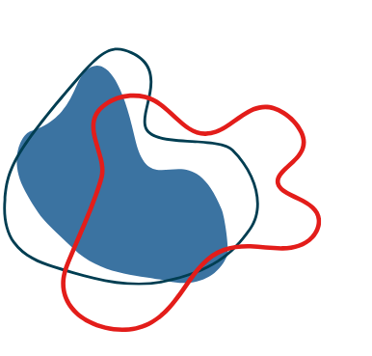

From Ideas to Impact
Advocacy moves from:
Identifying an issue
Developing a plan
Taking action
Evaluating impact
Notes:
Section 6.1: Title Slide – From Ideas to Impact
Advocacy moves from identifying an issue → developing a plan → taking action → evaluating impact.
Small steps build momentum: one letter, one meeting, one story can lead to system-wide change.
Interactive prompt: Ask: “What’s one issue in cystic fibrosis care or policy you’d love to see change?” Write answers on a board or digital tool (Mentimeter/Padlet)

Slide 3

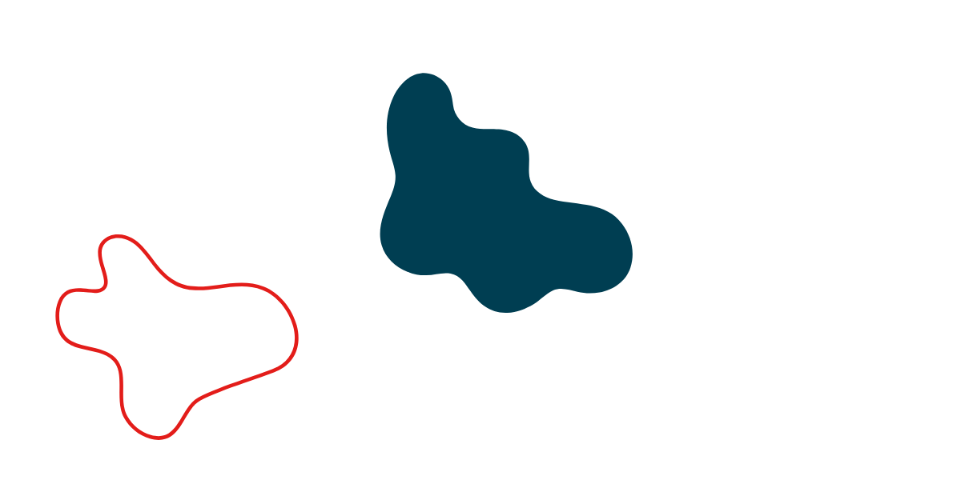
Creating a Campaign
Key steps:
Define SMART Goals
Petitions
Demonstrate broad community support.
Specific, Measurable, Achievable, Relevant, Time-bound.
Rallies and Awareness Days
Public visibility, media attention.
Identify Your Audience
Who has power to make the change?
Media Releases
Shape the narrative with journalists.
Plan a Timeline
Digital Strategy
Social media campaigns, hashtags, video content.
Set milestones for actions (letters, events, meetings).
Notes:
Section 6.2: Creating a Campaign – SMART goals, audiences, timelines
Key Steps:
Define SMART Goals – Specific, Measurable, Achievable, Relevant, Time-bound.
Identify Your Audience – who has power to make the change?
Plan a Timeline – set milestones for actions (letters, events, meetings).
DIY Activity: Participants write their own advocacy SMART goal. Example: “By December, collect 500 signatures to expand telehealth access for rural cystic fibrosis patients.”

Slide 4
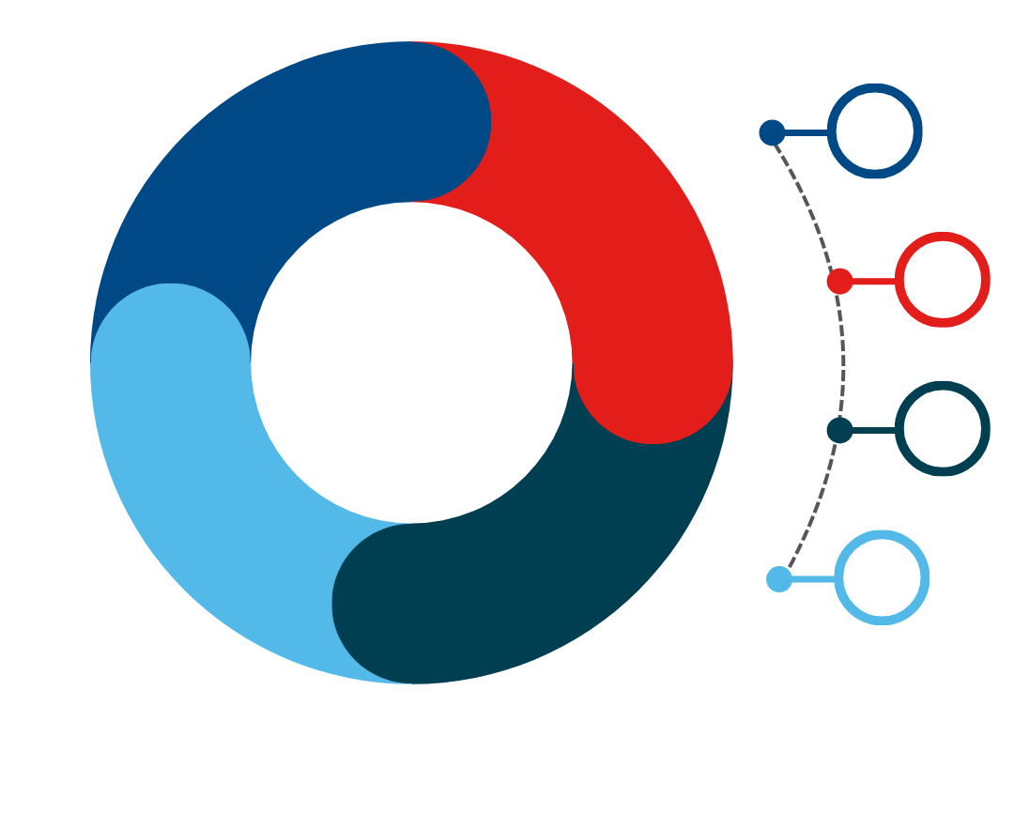

Tools of the Trade
Petitions
Demonstrate broad community support.
Rallies and Awareness Days
Public visibility, media attention.
Media Releases
Shape the narrative with journalists.
Digital Strategy
Social media campaigns, hashtags, video content.
Notes:
Section 6.3: Tools of the Trade – Petitions, Rallies, media releases, digital strategy
Petitions: Demonstrate broad community support.
Rallies & Awareness Days: Public visibility, media attention.
Media Releases: Shape the narrative with journalists.
Digital Strategy: Social media campaigns, hashtags, video content.
Scenario Activity: Give participants an issue (e.g., “improving hospital parking for families”). Ask them: Which tool would you use first? Why?

Slide 5
Building Coalitions
Strong advocacy happens through partnerships:
Allied health organisations
Other patient groups
Community groups and schools
Professional associations
Notes:
Section 6.4: Building Coalitions – Partnering with allied organisations and communities
Strong advocacy happens through partnerships:
Allied health organisations.
Other patient groups.
Community groups and schools.
Professional associations.
Coalitions broaden reach, resources, and legitimacy.
Activity: Small groups brainstorm which partners could strengthen a cystic fibrosis advocacy campaign on mental health support. Share ideas back.

Slide 6


Lobbying Decision-Makers
Steps for effective lobbying:
Request a meeting
Reach How many people engaged (signatures, social media views, event turnout).
Request to meet with your MP or Minister.
Responses Media coverage, official letters, MP replies.
Prepare materials
Outcomes Policy changes, funding commitments, service improvements.
Fact sheets, patient stories, clear “ask.”
Be concise
In the meeting, be concise (10-15 minutes), lead with your lived experience, reinforce with evidence
Follow-up
Send a thank-you email, repeat your ask, and keep the relationship ongoing.
Notes:
Slide 6.5: Lobbying Decision-Makers – Meetings, Materials, Follow-up
Steps for Effective Lobbying:
Request a meeting with your MP or Minister.
Prepare materials – fact sheets, patient stories, clear “ask.”
In the meeting: Be concise (10–15 minues), lead with lived experience, reinforce with evidence.
Follow-up: Send a thank-you email, repeat your ask, and keep the relationship ongoing.
Role-play Activity: One participant acts as an MP; others present their case for expanding Trikafta access. Swap roles to practice confidence.

Slide 7


Measuring Impact
Advocacy needs evaluation to show success and guide next steps.
Metrics include:
Reach How many people engaged (signatures, social media views, event turnout).
Responses Media coverage, official letters, MP replies.
Outcomes Policy changes, funding commitments, service improvements.
Notes:
Slide 6.6: Measuring Impact – Metrics: reach, responses, outcomes
Every campaign needs to measure success. Did it make a difference? Did it build momentum?
Advocacy needs evaluation to show success and guide next steps.
Metrics include:
Reach: How many people engaged (signatures, social media views, event turnout).
Responses: Media coverage, official letters, MP replies.
Outcomes: Policy changes, funding commitments, service improvements.
DIY Task: Provide a mock campaign summary (e.g., 2,000 petition signatures, 3 media articles, 1 MP speech). Ask: “How successful was this campaign? What could be improved?

Slide 8

Notes:
Wrap-Up – From Ideas to Action
Change doesn’t happen overnight — but it does happen when advocates stay organised, connected, and persistent. By setting SMART goals, choosing the right tools, building coalitions, lobbying decision-makers, and tracking impact, you can make real change happen for the cystic fibrosis community.
Take-Home Challenge: Ask participants to outline their own mini advocacy campaign in one page:
Their issue
SMART goal
Key audience
First step they’ll take

Slide 9

Notes:
https://forms.office.com/Pages/ResponsePage.aspx?id=yEdGupeeUUeAGk3aOs9mfr6xi9LyElFJmcdWLy1o6odUODhVVkEwSlZSTE1aNTMyNkI5QkpNMjQ0QS4u

