Slide 1

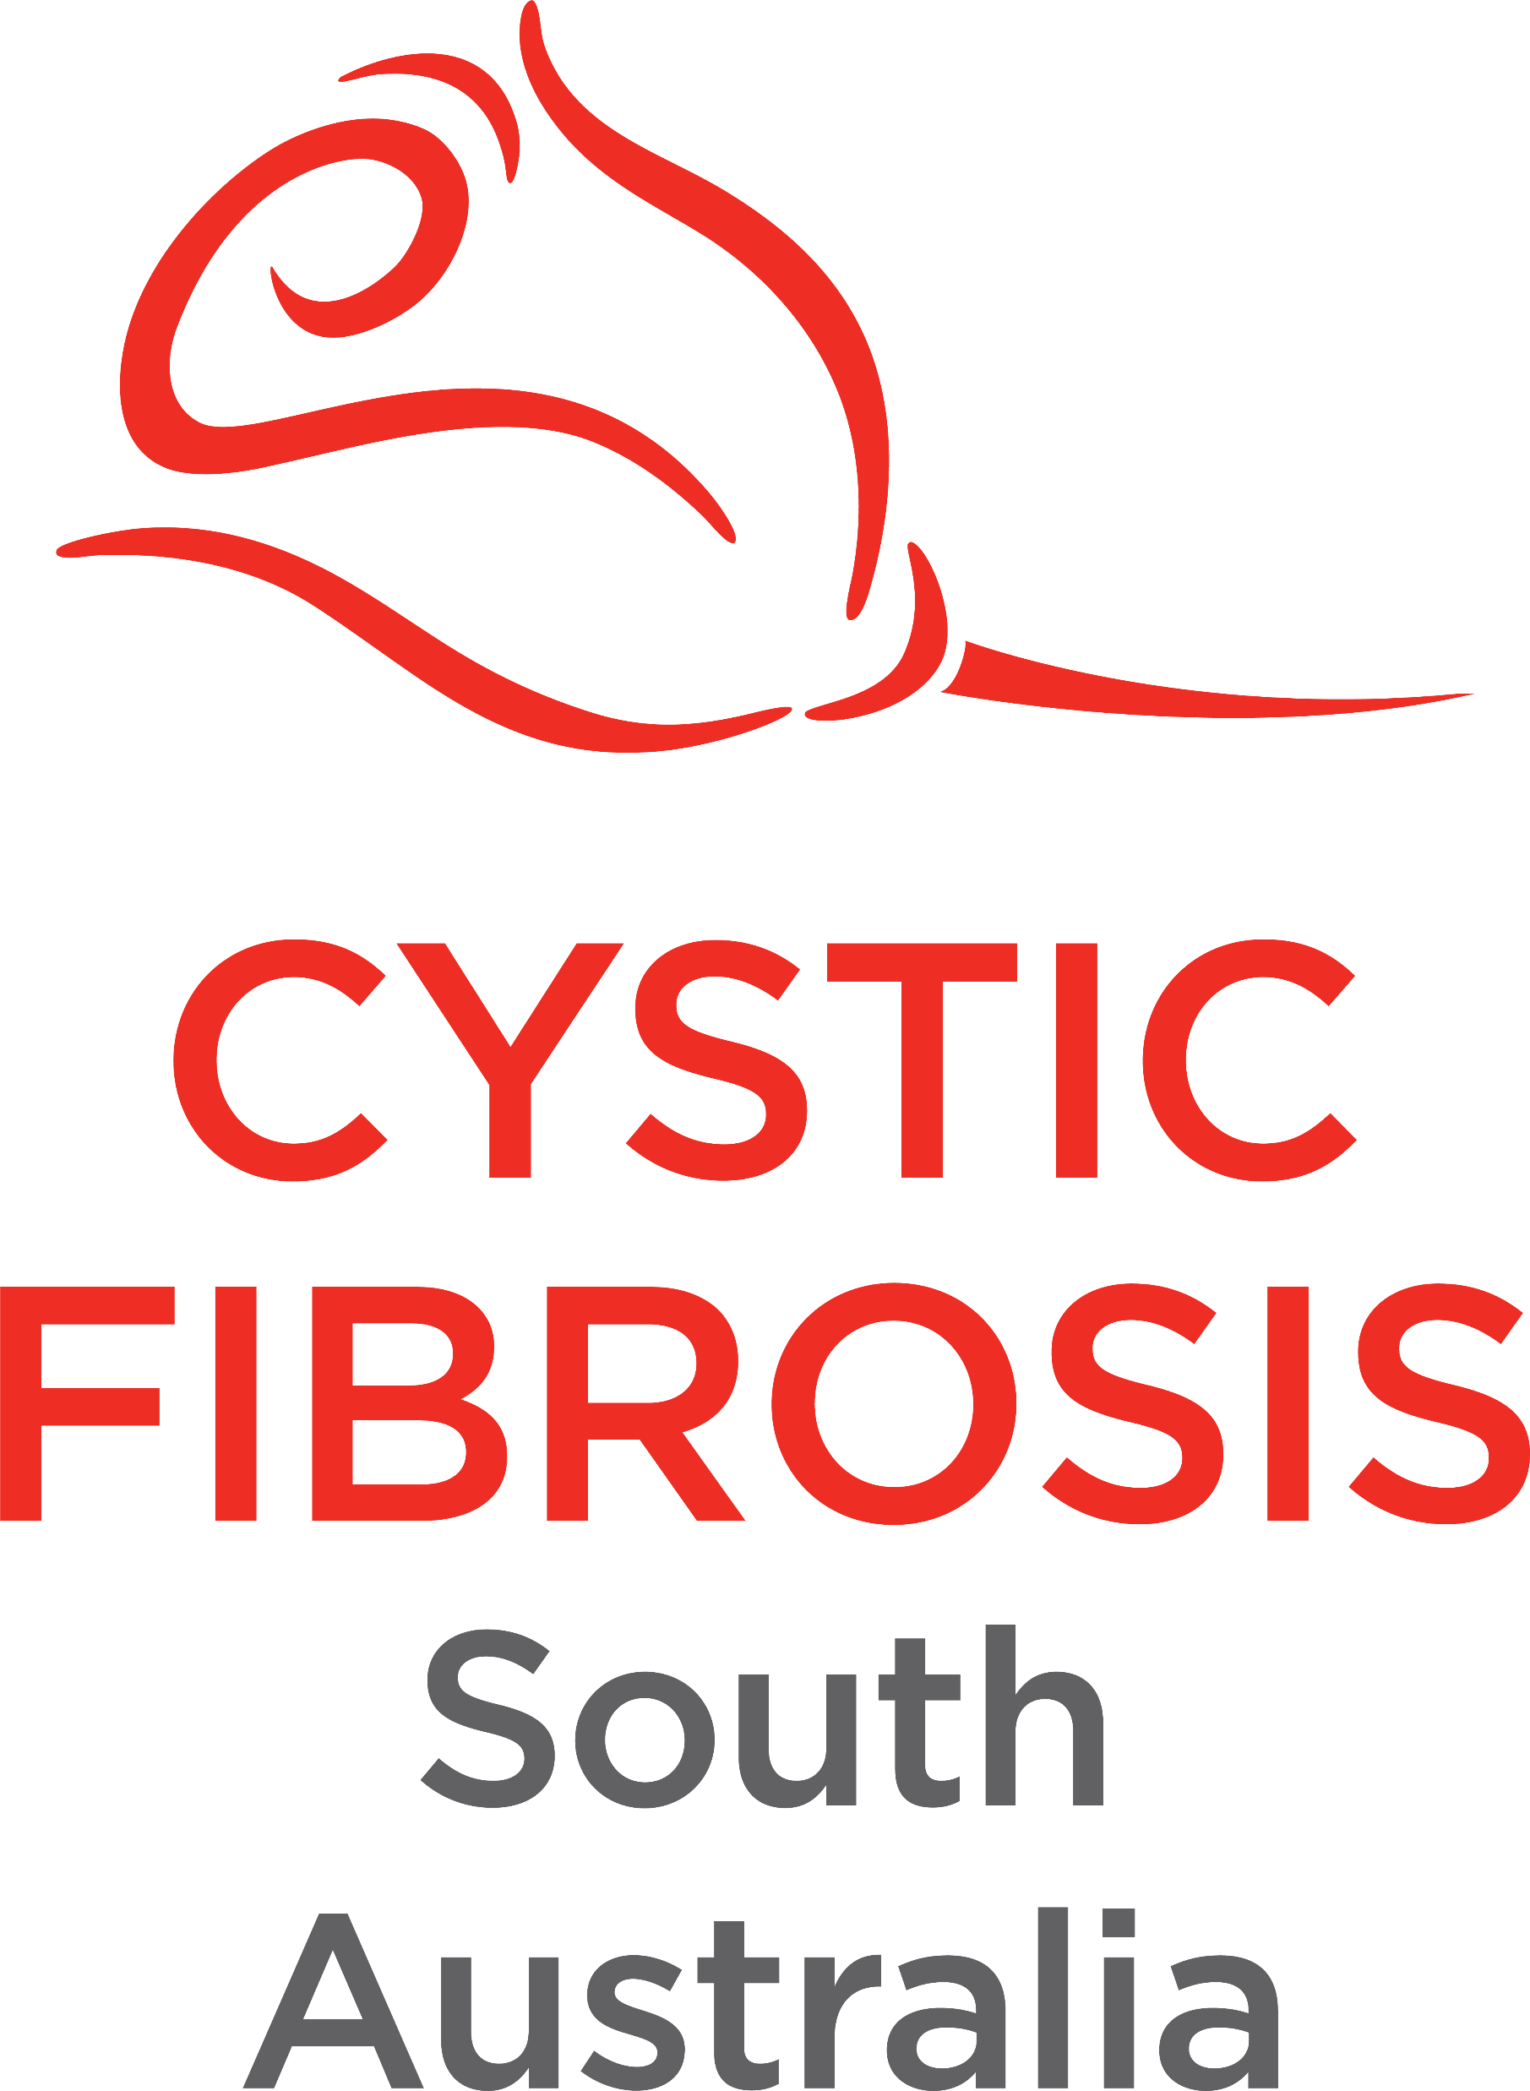
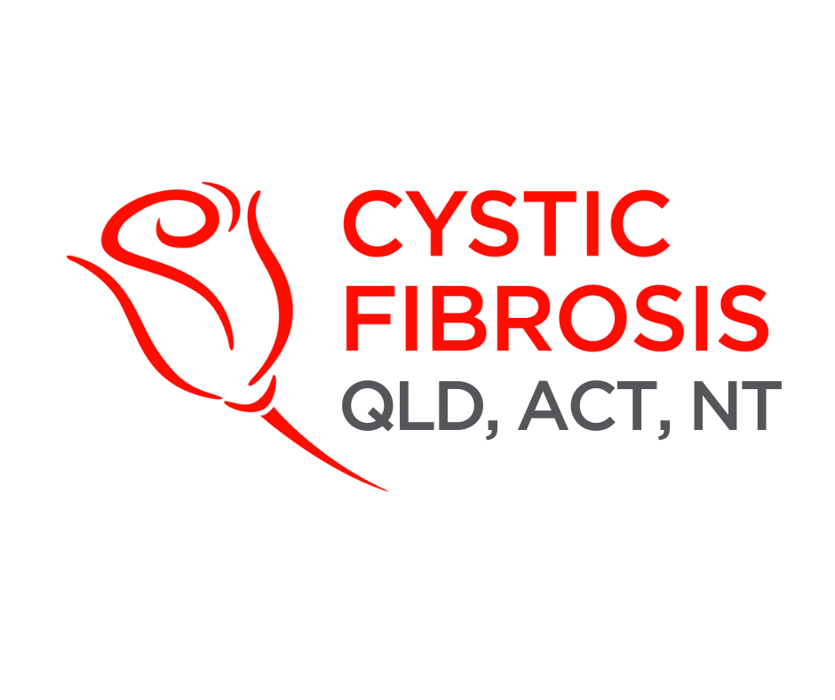
CF CAN
Module 7:
Self-Care for Advocates
Constant fatigue
Irritability
Withdrawing from activities
Headaches
Anxiety
Feeling disengaged
Trouble sleeping
Low motivation
Cystic Fibrosis Community Advocacy Network
Notes:
Module 7: Self-Care for Advocates
Section 7.1: Caring for the Advocate
Advocacy can be rewarding, but it also takes energy. Advocates often put others first and forget to care for themselves. Sustainable advocacy starts with recognising that your wellbeing matters too.
Icebreaker: Ask participants to reflect: “What’s one thing you do that helps you recharge?” Share with a partner or small group

Slide 2
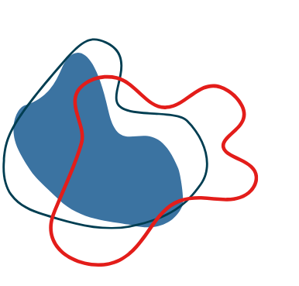
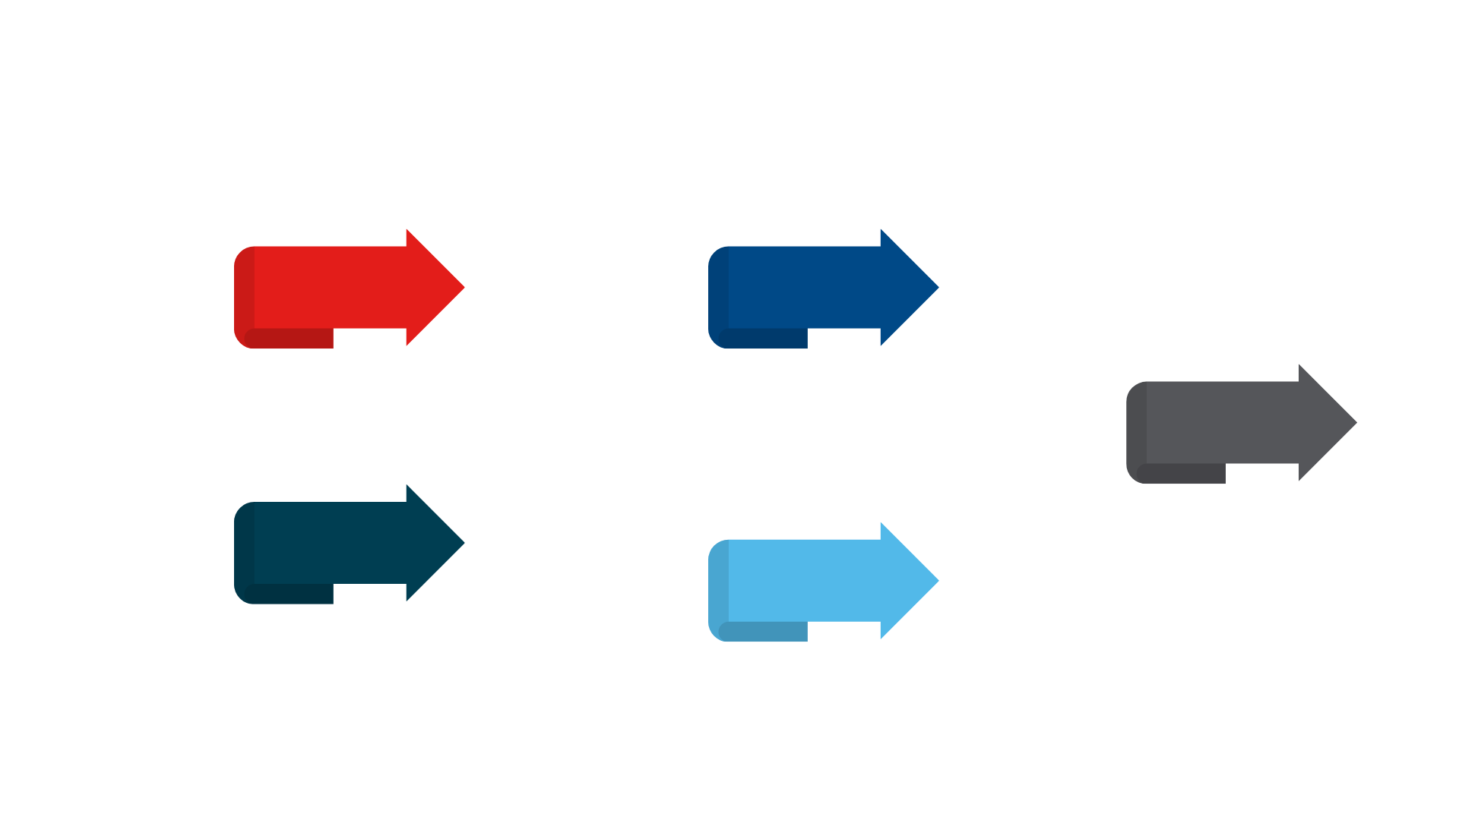

Recognising Burnout
Symptoms can include:
Physical
Emotional
Behavioural
Constant fatigue
Irritability
Withdrawing from activities
Saying “no” to opportunities when you’re at capacity.
Headaches
Anxiety
Feeling disengaged
Setting time limits on volunteering or advocacy tasks.
Trouble sleeping
Low motivation
Separating advocacy from personal/family time.
Prevention strategies:
Take regular breaks.
Balance advocacy
with other parts of life.
Share the load with peers or mentors.
Notes:
Section 7.2: Recognising Burnout – Symptoms, prevention
Burnout happens when the load becomes too heavy for too long.
Symptoms can include:
Physical – constant fatigue, headaches, trouble sleeping.
Emotional – irritability, anxiety, low motivation.
Behavioural – withdrawing from activities, feeling disengaged.
Prevention strategies:
Take regular breaks.
Balance advocacy with other parts of life.
Share the load with peers or mentors.
DIY Activity: Participants complete a quick self-check: Which burnout signs have I noticed in myself? Which prevention strategies could I try?

Slide 3


Delegation
Celebration
Reflection
Setting Boundaries
Boundaries protect your energy and make your advocacy more sustainable.
Examples of healthy boundaries:
Saying “no” to opportunities when you’re at capacity.
Setting time limits on volunteering or advocacy tasks.
Separating advocacy from personal/family time.
Notes:
Section 7.3: Setting Boundaries – Healthy limits, sustainable engagement
Boundaries protect your energy and make your advocacy more sustainable.
Examples of healthy boundaries:
Saying “no” to opportunities when you’re at capacity.
Setting time limits on volunteering or advocacy tasks.
Separating advocacy from personal/family time.
Scenario Activity: Small groups discuss: “You’ve been asked to speak at two events in the same week, but you’re exhausted. How could you respond while still supporting the cause?”

Slide 4
Practicing Sustainable Advocacy
Tips for sustainability:
Delegation
Share tasks with other advocates or team members.
Celebration
Acknowledge wins, no matter how small.
Reflection
Peer support groups
Regular check-ins
with fellow advocates.
Building a culture where rest and wellbeing are valued.
Regularly check in with yourself — is this pace sustainable?
Notes:
Section 7.4: Practicing Sustainable Advocacy – Delegation, celebration, reflection
Advocacy is a marathon, not a sprint.
Separating advocacy from personal/family time.
Delegation: Share tasks with other advocates or team members.
Celebration: Acknowledge wins, no matter how small.
Reflection: Regularly check in with yourself — is this pace sustainable?
DIY Task: Write down one way you could celebrate a recent advocacy effort (e.g., a thank-you message, team debrief, personal reward).

Slide 5

Community Care
Advocates thrive in strong, supportive communities.
Ways to practice community care:
1
2
3
Peer support groups
Regular check-ins
with fellow advocates.
Building a culture where rest and wellbeing are valued.
Join the CAC!
Made up of parents, adults living with cystic fibrosis, carers and community representatives, the Community Advisory Committee (CAC) provides ongoing guidance, feedback and strategic insight to help us remain responsive, inclusive and grounded in real community needs.
Our CAC runs a peer-to-peer support network for our community. Through facilitated online groups, one-on-one connections and shared resource exchanges, our peer network reduces isolation, fosters resilience and creates a safe space for emotional support and practical advice.
Notes:
Section 7.5: Community Care – Peer Groups, Check-ins, Wellness Culture
Advocates thrive in strong, supportive communities.
Ways to practice community care:
Peer support groups.
Regular check-ins with fellow advocates.
Building a culture where rest and wellbeing are valued.
Group Brainstorm: “What could a cystic fibrosis advocacy community do to support each other better?” Collect ideas on a whiteboard or Padlet.

Slide 6



Mindfulness and Resilience
Mindful tools:
Journalling
daily reflections.
Therapy or counselling.
Meditation or breathing exercises.
Wellness apps for guided mindfulness.
Notes:
Section 7.6: Mindfulness and Resilience – Tools: journalling, meditation, therapy, apps.
Resilience means bouncing back from challenges. Mindfulness tools can help.
Options include:
Journalling daily reflections.
Meditation or breathing exercises.
Therapy or counselling.
Wellness apps for guided mindfulness.
Guided Activity: Lead participants through a 2-minute breathing exercise

Slide 7

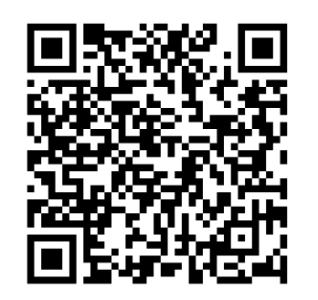
Mental Health First Aid
Cystic Fibrosis Queensland offers Mental Health First Aid (MHFA) – a nationally accredited, evidence-based training program that teaches participants how to identify, understand and respond to mental health challenges.
This two-day, in-person course equips individuals with the practical skills and confidence to support someone experiencing a mental health problem or crisis.
Learn more:
Scan the QR code
This program is provided free of charge to all Cystic Fibrosis Queensland members across Australia, including their family members and carers.
OR
Click here
services@cfqld.org.au

Slide 8


Slide 9

Notes:
https://forms.office.com/Pages/ResponsePage.aspx?id=yEdGupeeUUeAGk3aOs9mfr6xi9LyElFJmcdWLy1o6odUMVdOUEJEUEc2OEVVODhCOFdVWVM2R0JNVy4u

